Slide 1
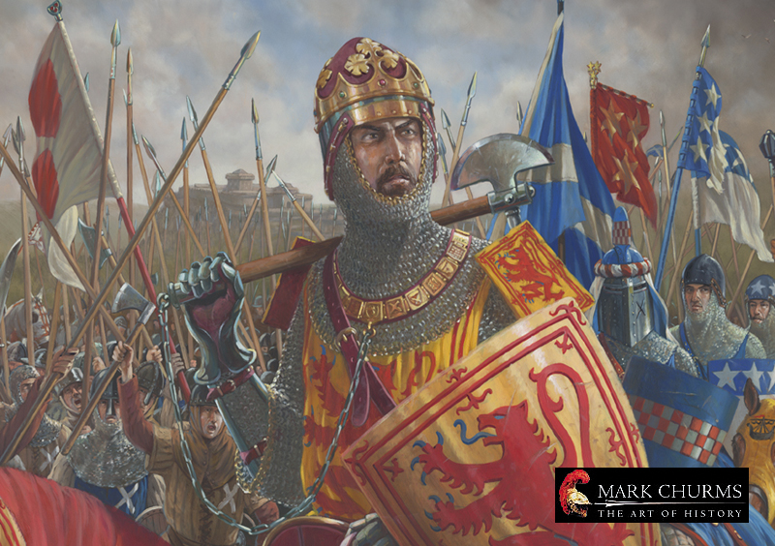
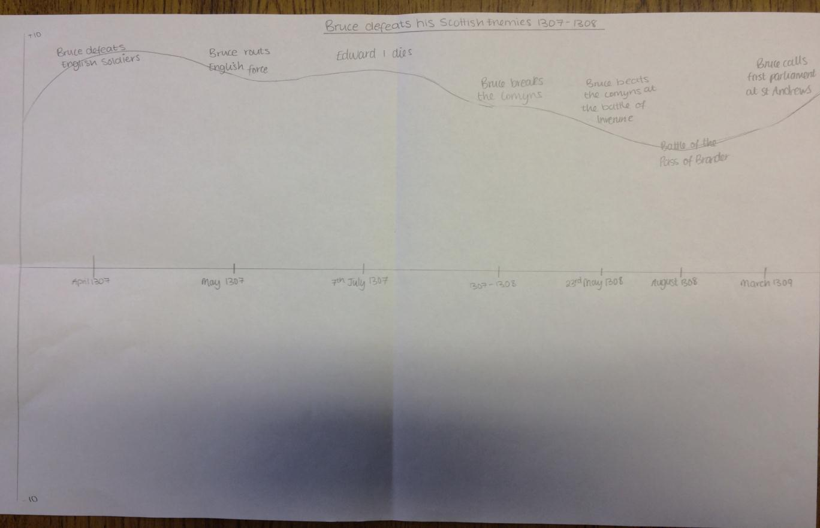
Describe how Robert Bruce defeated his Scottish enemies
Carrie Ann McGrath helps answer this common question

Slide 2
Describe how Robert Bruce defeated his English enemies

