Slide 1
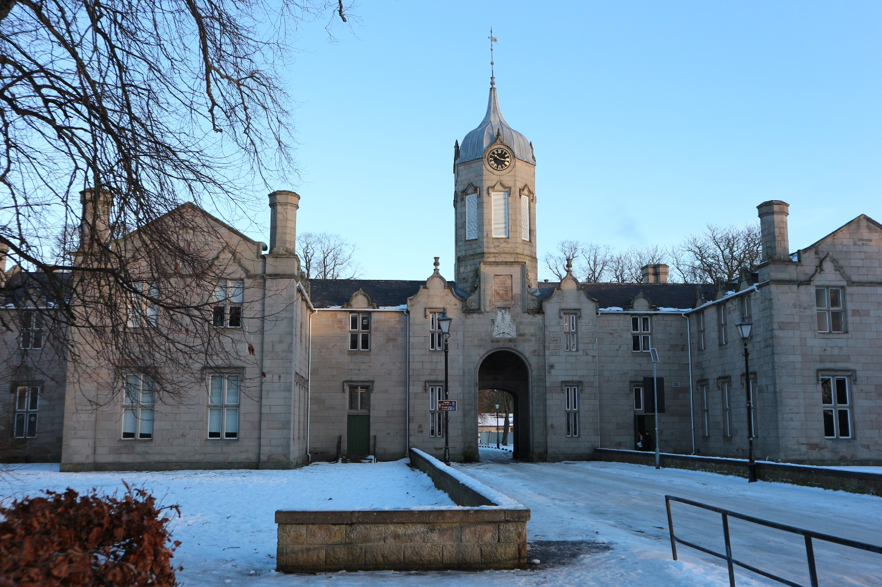
S3 into S4 Transition
Broad General Education into the Senior Phase
Curriculum Information Evening
Wednesday 10 January, 2018

Slide 2
Welcome and Aims
To reflect on our recent Attainment and progress
To give an outline of Curriculum for Excellence and confirm the rationale behind our transition into the Senior Phase (S4 – S6)
To give Parents/Carers the opportunity to ask any general questions around this transition
To explore the pathways which lead our pupils to secure positive destinations

Slide 3
Vison | Values
Together | Community | Cooperation | Respect
Growing | Happy | Healthy | Confident
Succeeding | Aspire | Achieve | Explore

Slide 4
Attainment Review
Making 2018-2020 Count

Slide 5
S4
We are measured on how many pupils in the S4 year group gain 5 or more Awards (A – D) at National 5 level:
2017 = 51%
2016 = 38%
We are also measured against a virtual school with 100 x more pupils across Scotland, who have similar characteristics to our pupils:
2017 = 51%
2016 = 52%

Slide 6
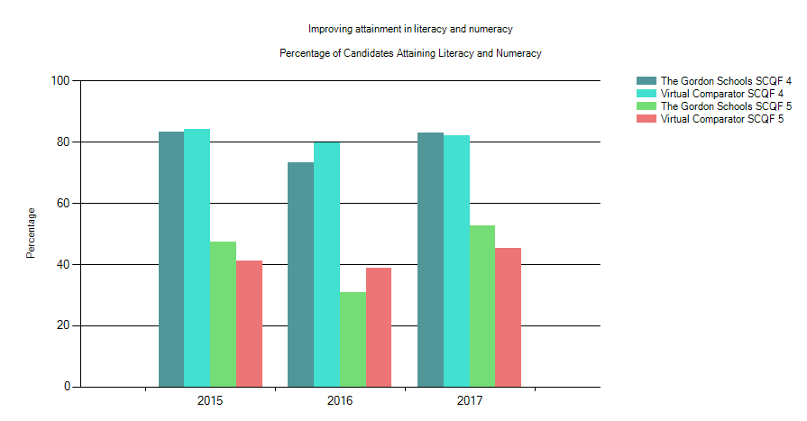
Literacy & Numeracy
Males in 2017

Slide 7
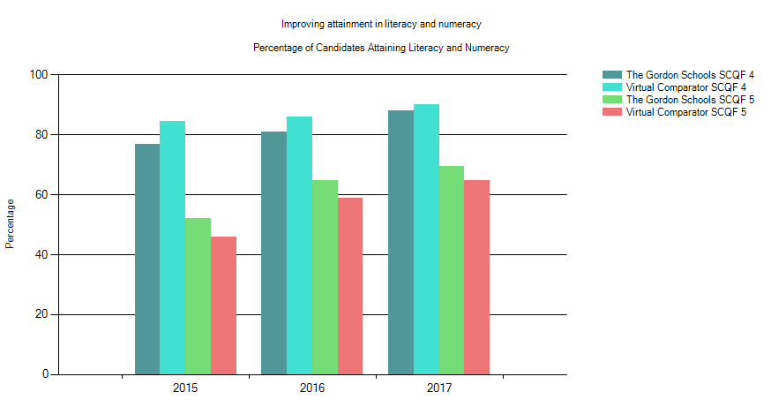
Literacy & Numeracy
Females in 2017

Slide 8
S5
We are measured on how many pupils in the S5 year group gain 3 or more Awards (A – D) at Higher level:
2017 = 34%
2016 = 28%
We are also measured against a virtual school with 100 x more pupils across Scotland, who have similar characteristics to our pupils:
2017 = 41%
2016 = 40%

Slide 9
S6
We are measured on how many pupils in the S6 year group gain 5 or more Awards (A – D) at Higher level:
2017 = 39%
2016 = 31%
We are also measured against a virtual school with 100 x more pupils across Scotland, who have similar characteristics to our pupils:
2017 = 53%
2016 = 33%
*** Health Warning***

Slide 10
Supporting Pupils to Achieve and Aspire
Team Game – Parents / Carers, Pupils, Community, SLT, FHs, Teachers & Support Colleagues
“Hard Work Beats Talent When Talent Doesn’t Work Hard”
Resilience – be inspired to do better
Maths and English – Literacy and Numeracy are key skills for all learning
Learning Conversations – Knowing where you are in your learning and how to improve.
Strong Attendance = Stronger Qualifications

Slide 11
National Curriculum Structure
S1, 2, 3 – Broad General Education
(Skills & Knowledge development)
S4, 5, 6 – Senior Phase
(Certification – SQA and other Awards)
Positive (post-school) Destination
Notes:
Linda

Slide 12
The Curriculum
The Curriculum is defined as the “totality of learners’ experiences both in and out of school”
Partnership working is key
Senior Phase opportunities which support each pupil’s learning pathway
Differentiation, support and challenge
Developing resilience, encouraging aspiration
S4/5/6 is for certification and ensuring Positive Leaver Destinations

Slide 13
CfE National Qualifications
SQA Qualifications in the Senior Phase:
Internally assessed by TGS -
SQA verify our standards
Externally assessed by SQA exams and coursework marks

Slide 14
Options Process
Where to start…?
Notes:
Dawn

Slide 15
The S3 Preference Form
Preferences were made from the Curriculum Areas to ensure a balance within the Broad General Education.
A free preference was also included to personalise the curriculum and respond to interest and aptitude.
Notes:
Dawn

Slide 16
Transition from S3 into S4
Decisions
Enjoyment / Challenge / Interest
Strengths / Development needs
Skill sets
Future career intentions
Advice of Teachers
Discussion with Parents / Carers
Progression Pathways
Support
Interim & Full Reports
Guidance Discussions
Parents’ Meeting discussions
Nationals in a Nutshell
Work Experience
Skills Development Scotland
It’s important that each individual pupil considers their decisions.
Friendship groups and Teachers may change over time.
Creating a pathway(s) that will bring you to your chosen
positive destination and having options should you need them.
Notes:
Dawn

Slide 18
What does Senior Phase choice look like?
S4 (S5) (S6) | Option One N2 – N5 | Option Two N2 – N5 | Option Three N2 – N5 | Option Four N2 – N5 |  | Option Five N2 – N5 |  | Option Six N3 – N5 | PSE | RMPS | PE
S5 S6 | Option 1 Higher (Adv) | Option 2 Higher (Adv) | Option 3 Higher (Adv) |  | Option 4 Higher (Adv) |  | Option 5 Higher (Adv) |  | PSE | PE | Elective
Year | Subject Combination
S4 | Maths & English + 4 Choices + WA?
S5 | 5 Subjects + WA
S6 | 4 Subjects* + WA

Slide 19
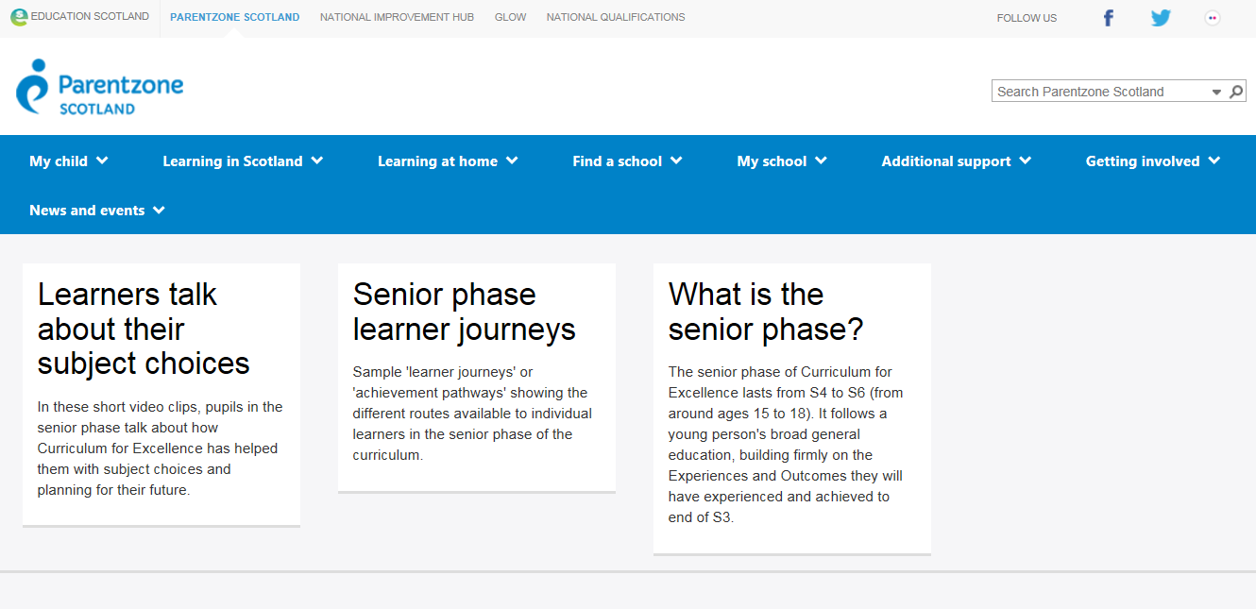
On the internet:
https://education.gov.scot/parentzone/learning-in-scotland/senior-phase

Slide 20
http://www.npfs.org.uk/nationals-in-a-nutshell/
http://www.npfs.org.uk/highers-in-a-nutshell/

Slide 22
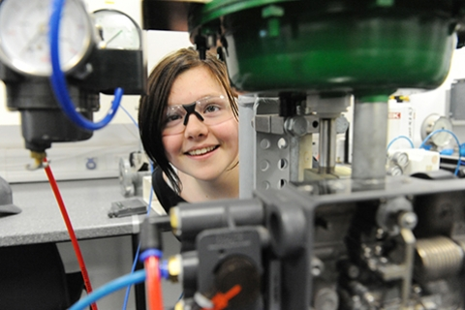
“The objective of our School College links programme is to offer a broad range of vocational education opportunities that introduce pupils to industry relevant knowledge whilst developing transferable skills that support transition to the workplace at the level most suited to their individual aspirations.”

Slide 23
Subject Areas include:
Digital Media
Civil Engineering
Construction
Automotive
Early Education and Childcare
Health Sector
Computing
Sport
Hospitality
Travel and Tourism
Marketing and Events
Psychology
Engineering
Accountancy
Laboratory Science
Beauty Therapy
Maritime
Those in bold were courses taken by TGS pupils during 2016-17

Slide 24
Qualifications include:
SQA N5’s and Highers
Skills for Work at N4 and N5
City and Guilds Awards
National Progression Awards
Foundation Apprenticeships
Professional Development Awards
College Certificates
TGS 16-17: 25 pupils achieved Awards at Level 4 and Level 5

Slide 25
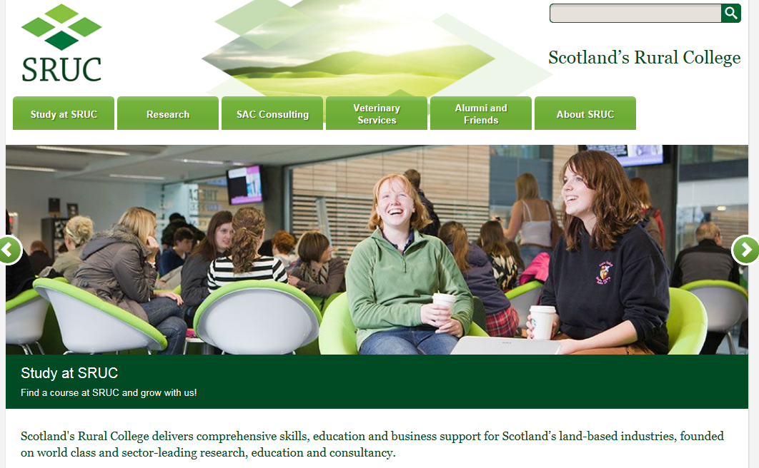
National Progression Award in Rural Skills
TGS 16-17: 5 pupils achieved this Award
at Level 5

Slide 26
YASS
Young Applicants Scheme in Scotland
for S6 pupils
The Open University
Modules such as:
Understanding the autistic spectrum
Law in Scotland
Maths for science
The frozen planet
Living without oil: chemistry for a sustainable future
Galaxies, stars and planets
Molecules, medicines and drugs: a chemical story

Slide 27
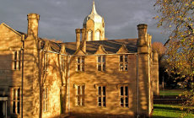
Questions?

