Slide 1
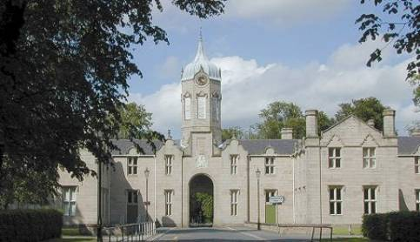

S3 into S4 Transition
Broad General Education into the Senior Phase
Curriculum Information Evening
Wednesday 23 January, 2019

Slide 2

Welcome and Aims
To reflect on our recent Attainment and progress
To give an outline of Curriculum for Excellence and confirm the rationale behind our transition into the Senior Phase (S4 – S6)
To give Parents/Carers the opportunity to ask any general questions around this transition
To explore the pathways which lead our pupils to secure positive destinations

Slide 3

Vison | Values
Together | Community | Cooperation | Respect
Growing | Happy | Healthy | Confident
Succeeding | Aspire | Achieve | Explore

Slide 4

Attainment Review
Making 2018-2020 Count

Slide 5

S4
We are measured on how many pupils in the S4 year group gain 5 or more Awards (A – D) at National 5 level:
2018 = 47%
2016 = 38%

Slide 6
S5
We are measured on how many pupils in the S5 year group gain 3 or more Awards (A – D) at Higher level:
2018 = 41%
2017 = 34%
2016 = 28%

Slide 7
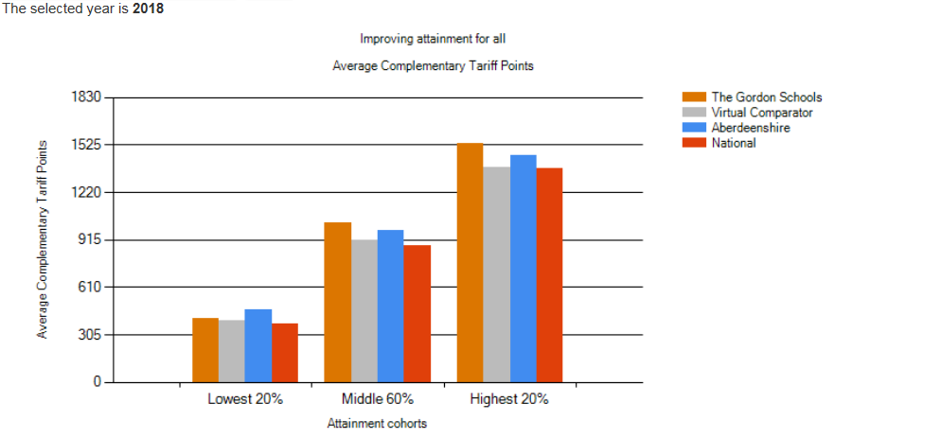
Annual total average points total for
middle 60% at S6
Middle 60%
TGS 1027 points
A’shire 976 points
National 878 points

Slide 8
Supporting Pupils to Achieve and Aspire
Team Game – Parents / Carers, Pupils, Community, SLT, FHs, Teachers & Support Colleagues
“Hard Work Beats Talent When Talent Doesn’t Work Hard”
Resilience – be inspired to do better
Maths and English – Literacy and Numeracy are key skills for all learning
Learning Conversations – Knowing where you are in your learning and how to improve.
Strong Attendance = Stronger Qualifications

Slide 9
National Curriculum Structure
S1, 2, 3 – Broad General Education
(Skills & Knowledge development)
S4, 5, 6 – Senior Phase
(Certification – SQA and other Awards)
Positive (post-school) Destination
Notes:
Linda

Slide 10
The Curriculum
The Curriculum is defined as the “totality of learners’ experiences both in and out of school”
Partnership working is key
Senior Phase opportunities which support each pupil’s learning pathway
Differentiation, support and challenge
Developing resilience, encouraging aspiration
S4/5/6 is for certification and ensuring Positive Leaver Destinations

Slide 11
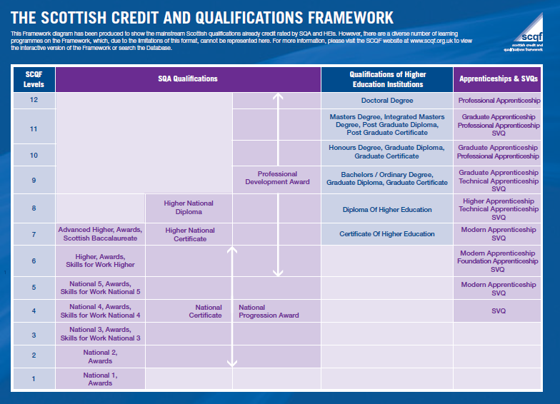

Slide 12
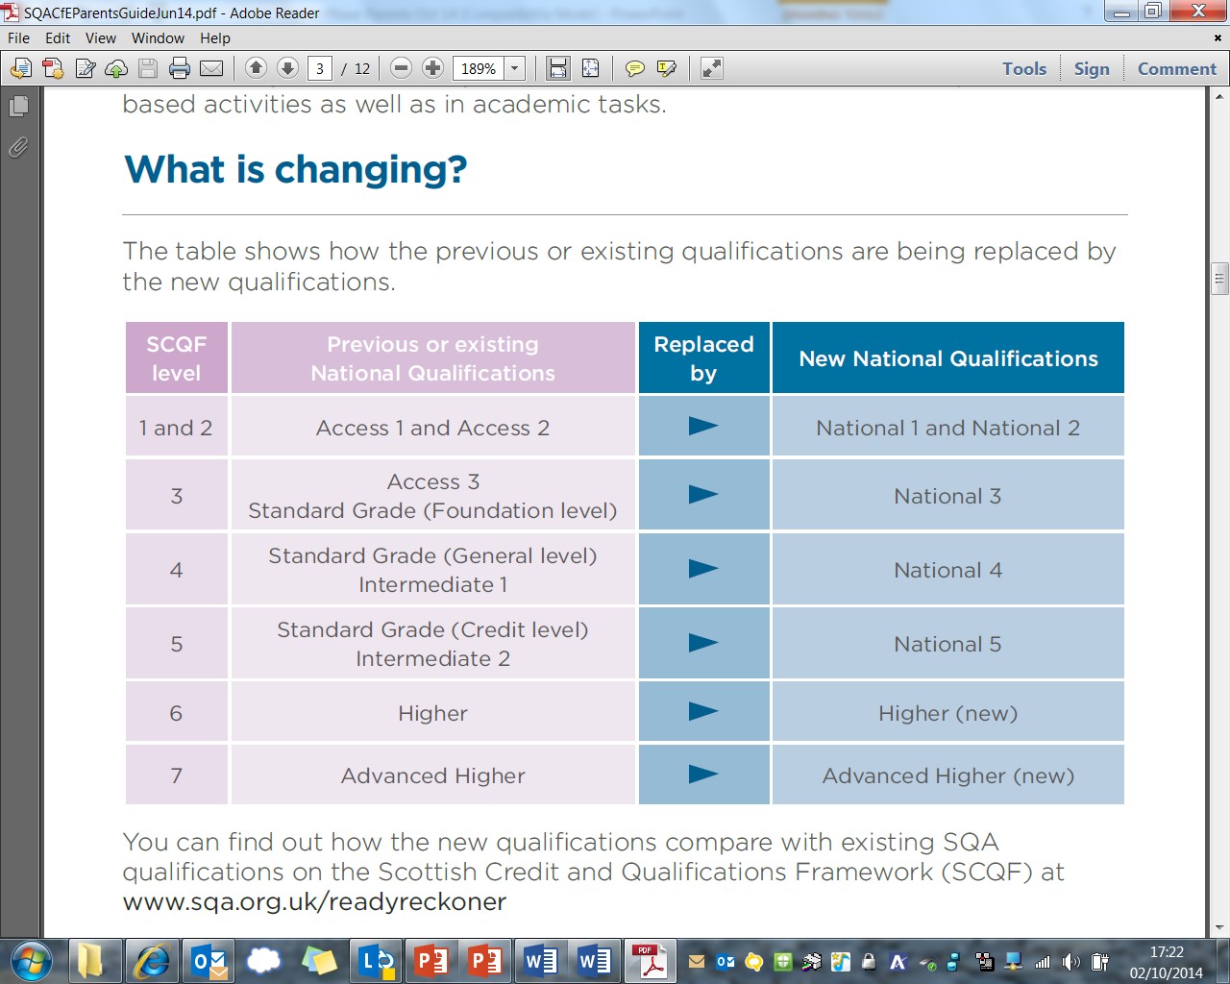
Curriculum for Excellence
National Qualifications
SQA Qualifications in the Senior Phase:
Internally assessed by TGS -
SQA verify our standards
Externally assessed by SQA exams and coursework marks

Slide 13

Options Process
Where to start…?
Notes:
Dawn

Slide 14
Transition from S3 into S4
Decisions
Enjoyment / Challenge / Interest
Strengths / Development needs
Skill sets
Future career paths
Advice of Teachers
Discussion with Parents / Carers
Progression Pathways
Support
Tracking & Full Reports
Guidance Colleagues
Parents’ Meeting discussions
Course information
Nationals in a Nutshell
Skills Development Scotland Careers Advisor
It’s important that each individual pupil considers their decisions.
Friendship groups and Teachers may change over time.
Creating a pathway(s) that will bring you to your chosen
positive destination and / or having broad options to draw upon.
Notes:
Dawn

Slide 15
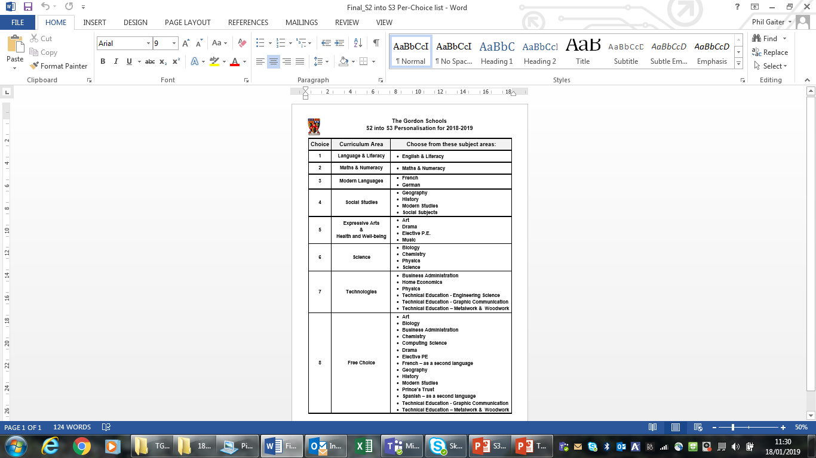
The S3 Preference Form
Preferences were made from the Curriculum Areas to ensure a balance within the Broad General Education.
A free preference was also included to personalise the curriculum and respond to interest and aptitude.
Notes:
Dawn

Slide 16
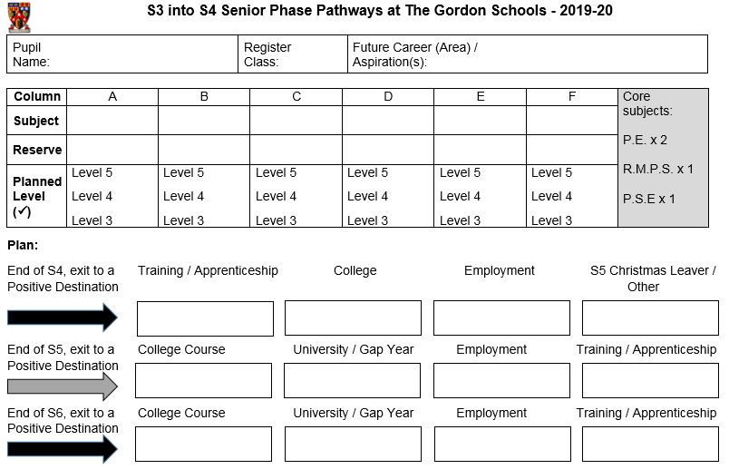

Slide 17
What does Senior Phase choice look like?
S4 (S5) (S6) | Option One L2 – L5 | Option Two L2 – L5 | Option Three L2 – L5 | Option Four L2 – L5 |  | Option Five L2 – L5 |  | Option Six L2 – L5 | PSE | RMPS | PE
S5 S6 | Option 1 Level 6 Higher (Adv) | Option 2 Level 6 Higher (Adv) | Option 3 Level 6 Higher (Adv) |  | Option 4 Level 6 Higher (Adv) |  | Option 5 Level 6 Higher (Adv) |  | PSE | PE elective | Elective
Year | Subject Combination
S4 | Maths* & English + 4 Choices + Wider Achievement
S5 | 5 Subjects* + Wider Achievement
S6 | 4 Subjects* + Wider Achievement

Slide 18
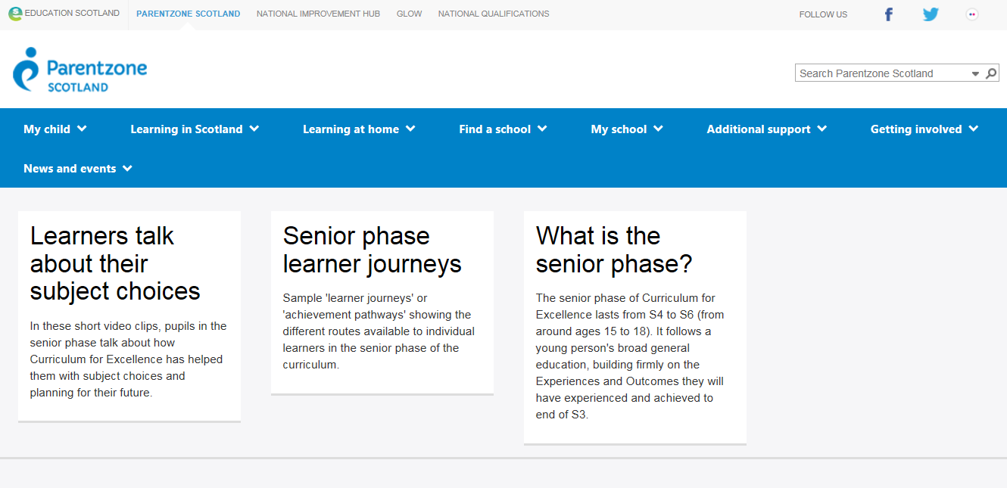
On the internet:
https://education.gov.scot/parentzone/learning-in-scotland/senior-phase

Slide 19
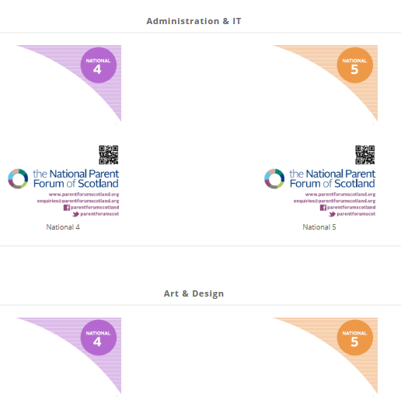
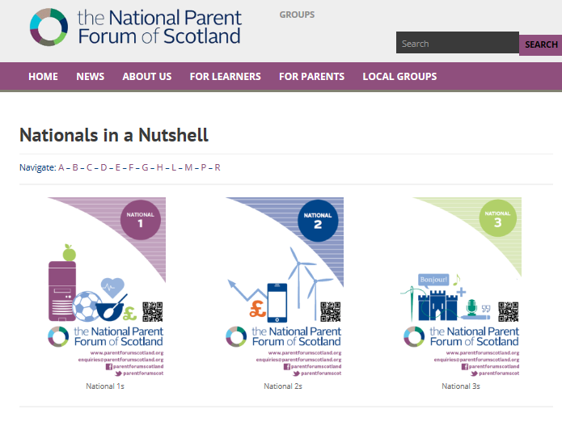
https://www.npfs.org.uk/downloads/category/in-a-nutshell-series/
nationals-in-a-nutshell-series/national-5/

Slide 20
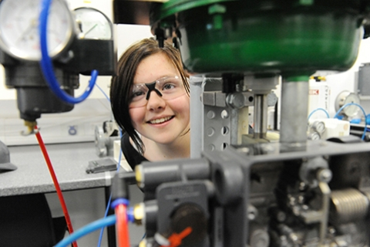
“The objective of our School College links programme is to offer a broad range of vocational education opportunities that introduce pupils to industry relevant knowledge whilst developing transferable skills that support transition to the workplace at the level most suited to their individual aspirations.”

Slide 21
Subject Areas include:
Digital Media
Civil Engineering
Construction
Automotive
Early Education and Childcare
Health Sector
Computing
Sport
Hospitality
Travel and Tourism
Marketing and Events
Psychology
Engineering
Accountancy
Laboratory Science
Beauty Therapy
Maritime
Those in bold are courses that have been taken by TGS pupils

Slide 22
Qualifications include:
SQA N5’s and Highers
Skills for Work at N4 and N5
City and Guilds Awards
National Progression Awards
Foundation Apprenticeships
Professional Development Awards
College Certificates
TGS 2017-18: 37 pupils achieved
Awards at Levels 4, 5 & 6

Slide 23
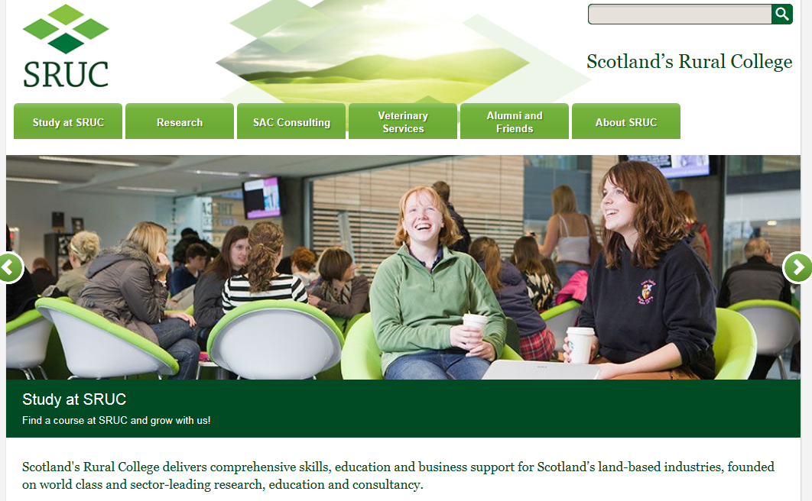
National Progression Award in Rural Skills
TGS 17-18:
Eight pupils achieved this Award at Level 5

Slide 24
YASS
Young Applicants Scheme in Scotland
for S6 pupils
The Open University
Nine passes in 17-18 in modules such as:
Understanding the autistic spectrum
Law in Scotland
Maths for science
The frozen planet
Living without oil: chemistry for a sustainable future
Galaxies, stars and planets
Molecules, medicines and drugs: a chemical story

Slide 25

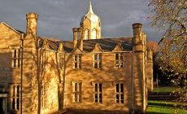
Questions?

Slide 26


Slide 27
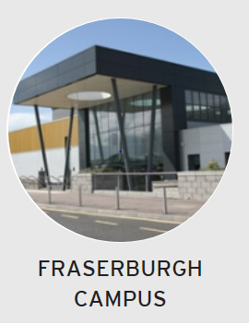
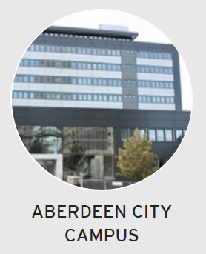
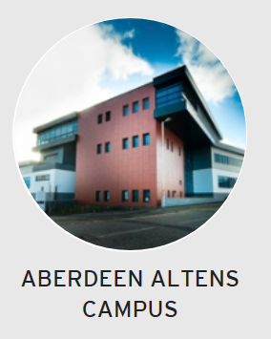
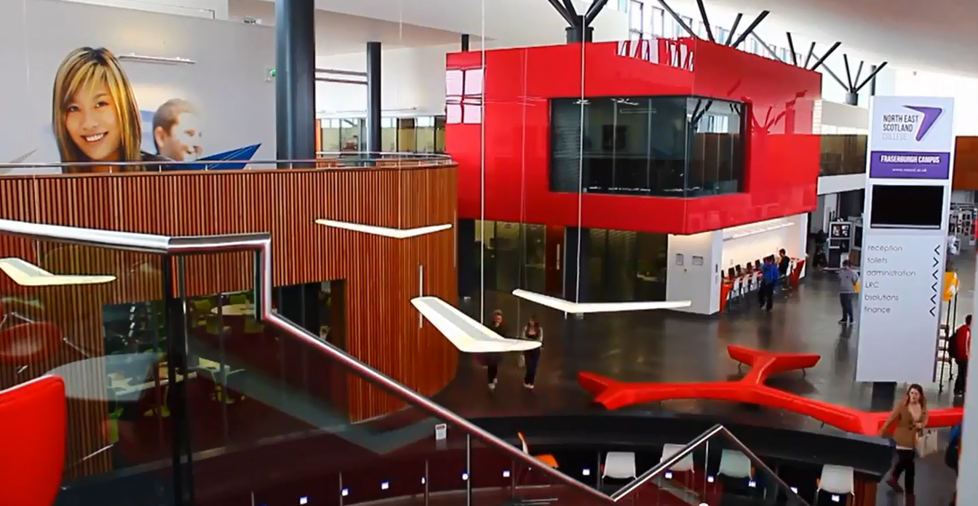
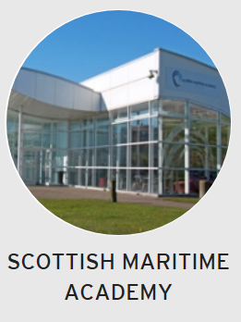
Who are we?
Notes:
Merged “Super College” Formerly Aberdeen College and Banff and Buchan college
Courses from Introductory Level to Advanced HND level with articulation to 33 HNC/D programmes articulating to 338 degree programmes
Around 350 College student articulate to 2nd or 3rd year of Degree programmes at RGU each year
30% of young people in North East progress to Full Time Study at NESCol
Schools in Engineering, Science and Technology, Creative Industries, Computing and Business Enterprise and Service Industries
Centre for Excellence in Maritime, Oil and Gas and Creative Industries

Slide 28

Career Education Opportunities
“Right Route to the Right Job, through the Right Course, via the Right information”
(15-24 Learner Journey Review May 2018)

Slide 29
“The objective of our School College links programme is to offer a broad range of vocational education opportunities that introduce pupils to industry relevant knowledge whilst developing transferable skills that support transition to the workplace at the level most suited to their individual aspirations.”

Slide 30
School College Links Courses
Study at School and College
Develop resilience and confidence
Enhance personal statement or CV
Develop skills and knowledge for employment

Slide 31
School College Links
When being taught by a College lecturer young people will be treated like a College student.
College is an adult learning environment and we expect the same adult behaviour of school pupils as we do of our full time students.
College courses can mean missing some school classes – so additional commitment to catching up on missed work is essential
When attending a College course we expect pupils to behave as though they are arriving at work – on time and well prepared

Slide 32
School College Links Courses
College staff will report on pupil attendance, behaviour and progress to school
A written progress report for school and parents will be prepared twice a year
Courses are certificated and support progression to further study, modern apprenticeships, training or employment.
Courses support pupils in developing key skills identified by employers as essential for entering the workplace

Slide 33
Subject Areas include:
Digital Media
Civil Engineering
Construction
Automotive
Early Education and Childcare
Health Sector
Computing
Sport
Hospitality
Photography
Travel and Tourism
Politics
Psychology
Engineering
Accountancy
Laboratory Science
Beauty Therapy
Maritime
Technical Theatre

Slide 34
Qualifications include:
SQA N5’s and Highers
Skills for Work at N4 and N5
City and Guilds Awards
National Progression Awards
Foundation Apprenticeships
Professional Development Awards
College Certificates

Slide 35
What is a Foundation Apprenticeship?
Foundation apprenticeships are delivered whilst pupils are still at school
Qualification obtained through a blend of learning with a training provider, work based learning and work experience
Taken as one of S5 subjects and achieved over two years – Equivalent to a Higher.
1st year one day per week or two half days spent in college (can be delivered in schools)
2nd year one day per week in work placement to complete SVQ vocational units
Some Frameworks are available in shorter delivery models but this would involve equivalent of 2 days per week out of school

Slide 36
Benefits of a Foundation Apprenticeship
Stand out from the crowd
Get a head start in a Modern Apprenticeship
Employees are more productive quicker
Pupils gain industry relevant qualifications that support progression to work, College or University
Early skills development gives pupils a step up on the career ladder

Slide 37
Foundation Apprenticeship Frameworks
Engineering
Civil Engineering
IT Hardware/System Support
IT Software
Creative and Digital Media
Scientific Technologies (Lab Skills)
Food and Drink Technologies
Social Care and Healthcare*
Social Care – Children and Young People*
Business Skills*
Accountancy*
* Above are available in one year delivery models

Slide 38
Contact Us
Any queries from pupils or parents can be answered in school by Guidance Staff or please email us at:
schools@nescol.ac.uk
We are also on Twitter and Facebook for regular updates!
www.facebook.com/NESColLinks
www.twitter.com/NESColLinks

Slide 39


