Slide 1
What about drugs?
Substance Misuse

Slide 2
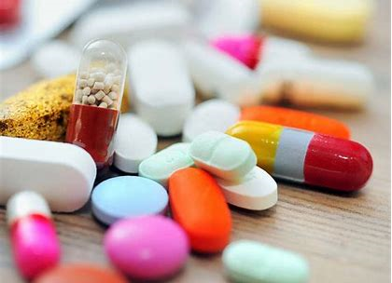
In this lesson you will:
Think about the effect drugs can have on behaviour and the decisions people make
Learn how drugs can lead to unplanned sexual activity
Consider the long-term consequences of experimenting using drugs

Slide 3
Starter:
In small groups brainstorm the different ways that drugs can affect behaviour and decisions.
Use the large piece of paper to write as many as you can.
We will share them as a whole class so be prepard to talk.

Slide 4
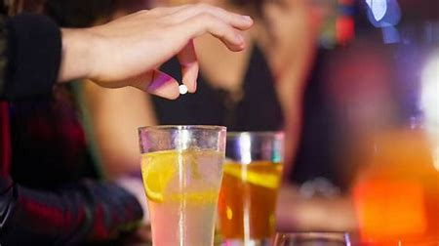
Whose decision?
When you are at a party in a friend's house, are you always confident that no-one could have put a drug into your drink? Do you ever leave it unattended? Do you ever let anyone else get a drink for you? If you answered yes to any of these questions, then there is a chance that you could become a victim of drug assisted sexual assault. Drug-assisted sexual assault, or drug rape as it is more commonly known, can be defined as the administering of a drug against an individual's wishes, or without their knowledge, which incapacitates or disorientates the individual with the whether you are male or female.

Slide 5
Task
Work together in groups to create a checklist that all young people should follow to prevent their drink being 'spiked'.
Be ready to share your checklist with the class and discuss what you have written.

Slide 6
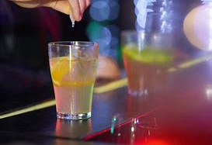
Discussion
On your table groups, discuss what advice you would give to a person who thinks they have been drug-assisted sexually assaulted.
Be ready to feedback your ideas and discussions to the whole class.

Slide 7
Activity: Remember: Having a criminal record can make it difficult for you to get a job or visa if you want to travel abroad.
You will have just been given a sheet which outlines the consequences for the people below:
1. Julie is stopped and searched by the police. She has ecstasy tablets for herself and friends in her pocket.
2. Robin has recently moved house after being charged with possession of Class C drugs. He has applied for lots of jobs but hasn't had an interview yet.
Mary and Douglas have four children and do not like their 16-year-old son's friends. He was charged recently with possession of drugs. Mary and Douglas have decided that they want the whole family to emigrate to Australia.

Slide 8
Extension:
Investigate local news reports from your own area.
What reports have been made that make reference to substance misuse?
What is your local community doing to address these issues?

