Slide 1
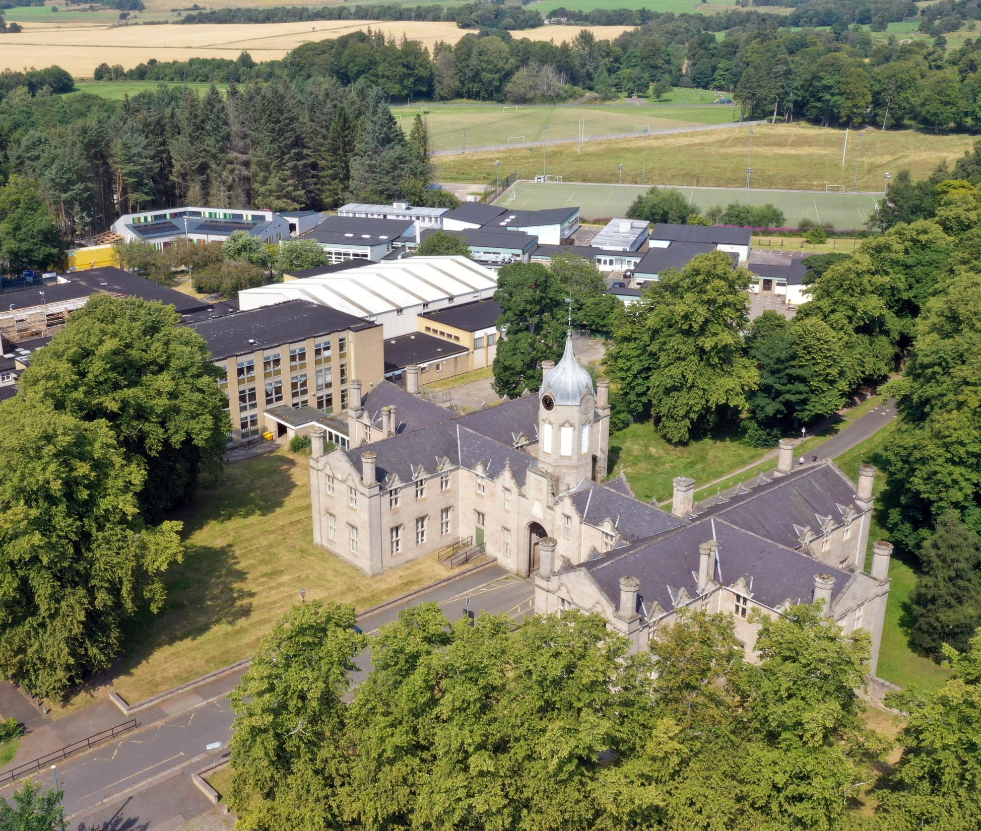
S2 Broad General Education:
Personalising the transition into S3
Curriculum Information
Presentation
February 2022

Slide 2
Welcome & Aims
To place transition within the context of our TGS Vision and reflect on our recent Attainment and progress
To give an outline of Curriculum for Excellence and confirm the rationale behind our transitions in the Broad General Education (S1 – S3)
To explore future pathways which lead our pupils to secure positive destinations
To give Parents/Carers the opportunity to ask any general questions around this transition

Slide 3
TGS Vision | What we aspire to…
Together | We all feel included in our School community, local Huntly community and the north-east, national and global world. We consider the consequences our actions have on others and our wider environment.
Growing | We value and look after our physical, mental, emotional and spiritual health. TGS as a happy place with support where everyone can develop confidence and resilience for life in and beyond School.
Succeeding | Being the best possible version of yourself that you can be. Each individual learning and achieving as much as they can. Explore new things with a growth mind-set for future success.

Slide 4
A review of our attainment
Celebrating successes and
learning lessons
2016-2021

Slide 5
S4
We are measured on how many pupils in the S4 year group gain 5 or more Awards (A – D) at National 5 level:
2021 = 53.4%
2019 = 47.5%
2018 = 47%
2017 = 51%
2016 = 38%
TGS also has great success and celebrates pupils who gain SQA & other Awards at
National 1, 2, 3 and 4 levels.
2020 TGS National 5 Grades:
(these were awarded based on Teacher Professional Judgement)
Grade A Pass 248 / 39% Grade C Pass 160 / 25%
Grade B Pass 160 / 25% Grades A – D Awards 611 / 96%

Slide 6
S5
We are measured on how many pupils in the S5 year group gain 3 or more Awards (A – D) at Higher level:
2021 = 35%
2019 = 42%
2018 = 41%
2017 = 34%
2016 = 28%
In S5, we also have good success and celebrate pupils who gain further SQA and other Awards at
National 1, 2, 3 and 4 levels as well as Foundation Apprenticeships.
2020 TGS S5/6 Higher Grades:
(these were awarded based on Teacher Professional Judgement)
Grade A Pass 135 / 38% Grade C Pass 79 / 22%
Grade B Pass 98 / 28% Grades A – D Awards 342 / 96%

Slide 7
National Curriculum Structure
S1, 2, 3 – Broad General Education
(Skills & Knowledge development)
S4, 5, 6 – Senior Phase
(Certification – SQA and other Qualifications & Awards)
Positive (post-school) Destination(s)
Notes:
Linda

Slide 8
The Curriculum
The Curriculum is defined as the “totality of learners’ experiences both in and out of school”
Partnership working is key: e.g. NESCol
Senior Phase opportunities supporting each pupil’s learning pathway, e.g. Foundation Apprenticeships
Appropriate differentiation, support and challenge
Developing resilience, encouraging aspiration
S4/5/6 is for certification and ensuring Positive Leaver Destinations + Skills for learning, life & work

Slide 9
Options Process
Where to begin…?
Notes:
Dawn

Slide 10
Supporting Pupils to Achieve and Aspire
Team Game – Parents / Carers, Pupils, Community, Teachers & Support Colleagues, FHs, PTs & SLT
Learning Conversations – Knowing where you are in your learning and next steps to improve
Stronger Attendance = Stronger Qualifications
“Hard work beats talent…
…when talent doesn’t work hard”
Resilience – be inspired to do better always

Slide 11
Transition from S2 into S3
Decisions
Enjoyment / Challenge / Interest
Strengths / Development needs
Skill sets & breadth vs depth?
Future career paths
Advice of Teachers
Discussion with Parents / Carers
Progression Pathways
Support
TGS Reporting
Guidance Colleagues
My World of Work
My Kids Career
TGS Course outlines
Nationals in a Nutshell
Skills Development Scotland (SDS) Advisor
It’s important that each individual pupil considers their decisions.
Friendship groups and Teachers may change over time.
Creating a pathway(s) that will bring you to your chosen
positive destination and / or having broad options to draw upon.

Slide 12
Progression Pathways
Expressive Arts example

Slide 13
Example of a TGS course descriptor
These can be accessed via the TGS website:
http://gordonschools.aberdeenshire.sch.uk/
Go to: Curriculum –
Course Choice
A one page document summarising the benefits, skills, assessments, progression &
career pathways of that subject

Slide 14
My World of Work
https://www.myworldofwork.co.uk/my-career-options/choosing-my-subjects

Slide 15
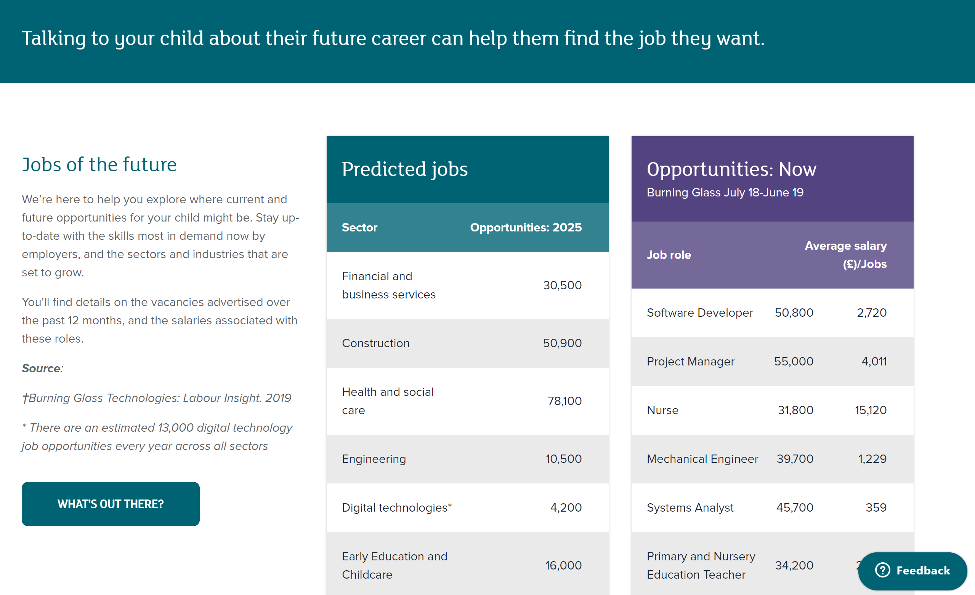
My Kid's Career
https://www.mykidscareer.com/

Slide 16
S3 Options
Personalising from the
Curriculum Areas
noting first preferences
& second preferences
Screenshot from Form here
Notes:
Dawn

Slide 18
What does S4/5/6 Senior Phase choice look like?
S4 (S5) (S6) | Option One L2 – L5 | Option Two L2 – L5 | Option Three L2 – L5 | Option Four L2 – L5 |  | Option Five L2 – L5 |  | Option Six L2 – L5 | PSE | RMPS | PE
S5 S6 | Option 1 Level 6 Higher (Adv) | Option 2 Level 6 Higher (Adv) | Option 3 Level 6 Higher (Adv) |  | Option 4 Level 6 Higher (Adv) |  | Option 5 Level 6 Higher (Adv) |  | PSE | PE elective | Elective
Year | Subject + Achievement combination
S4 | Maths & English + 4 Choices + Wider Achievement
S5 | 5 Subjects
S6 | 4 Subjects

Slide 19
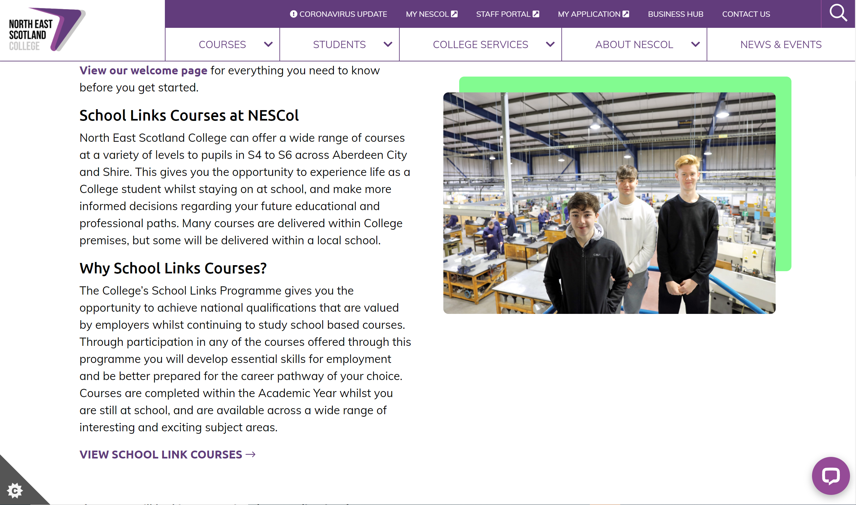
North East Scotland’s College: NESCol
School Link Courses
School Links - North East Scotland College (nescol.ac.uk)

Slide 20
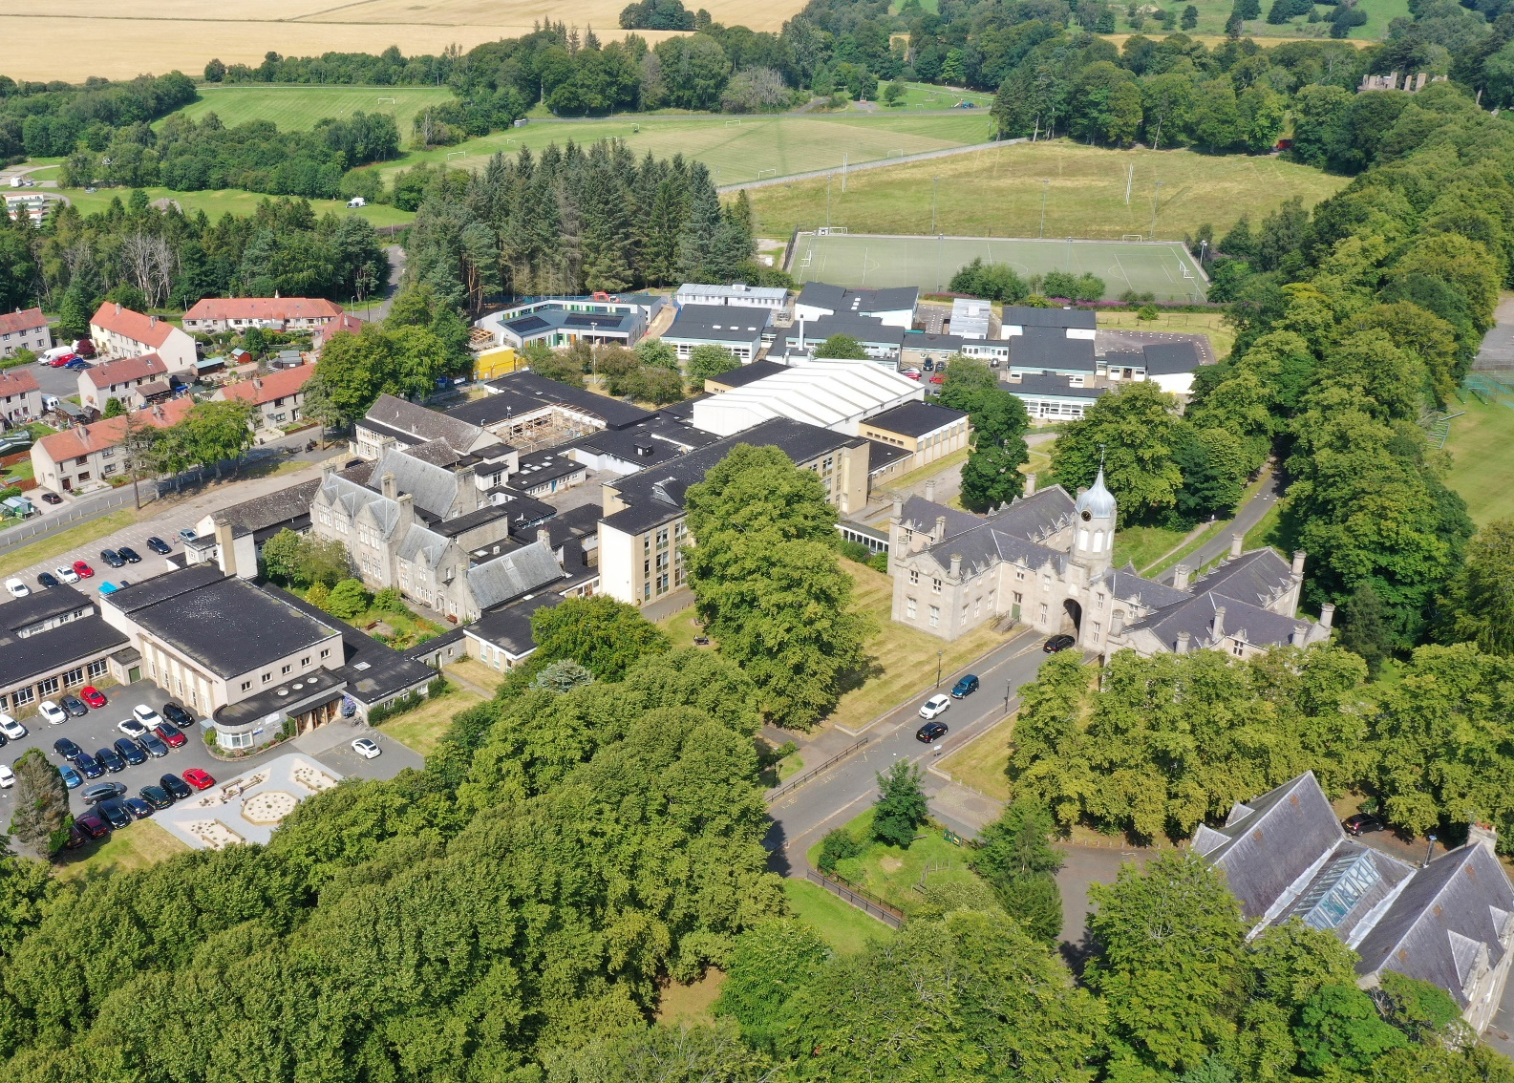
Your questions? gordonschools.aca@aberdeenshire.gov.uk

