Slide 1
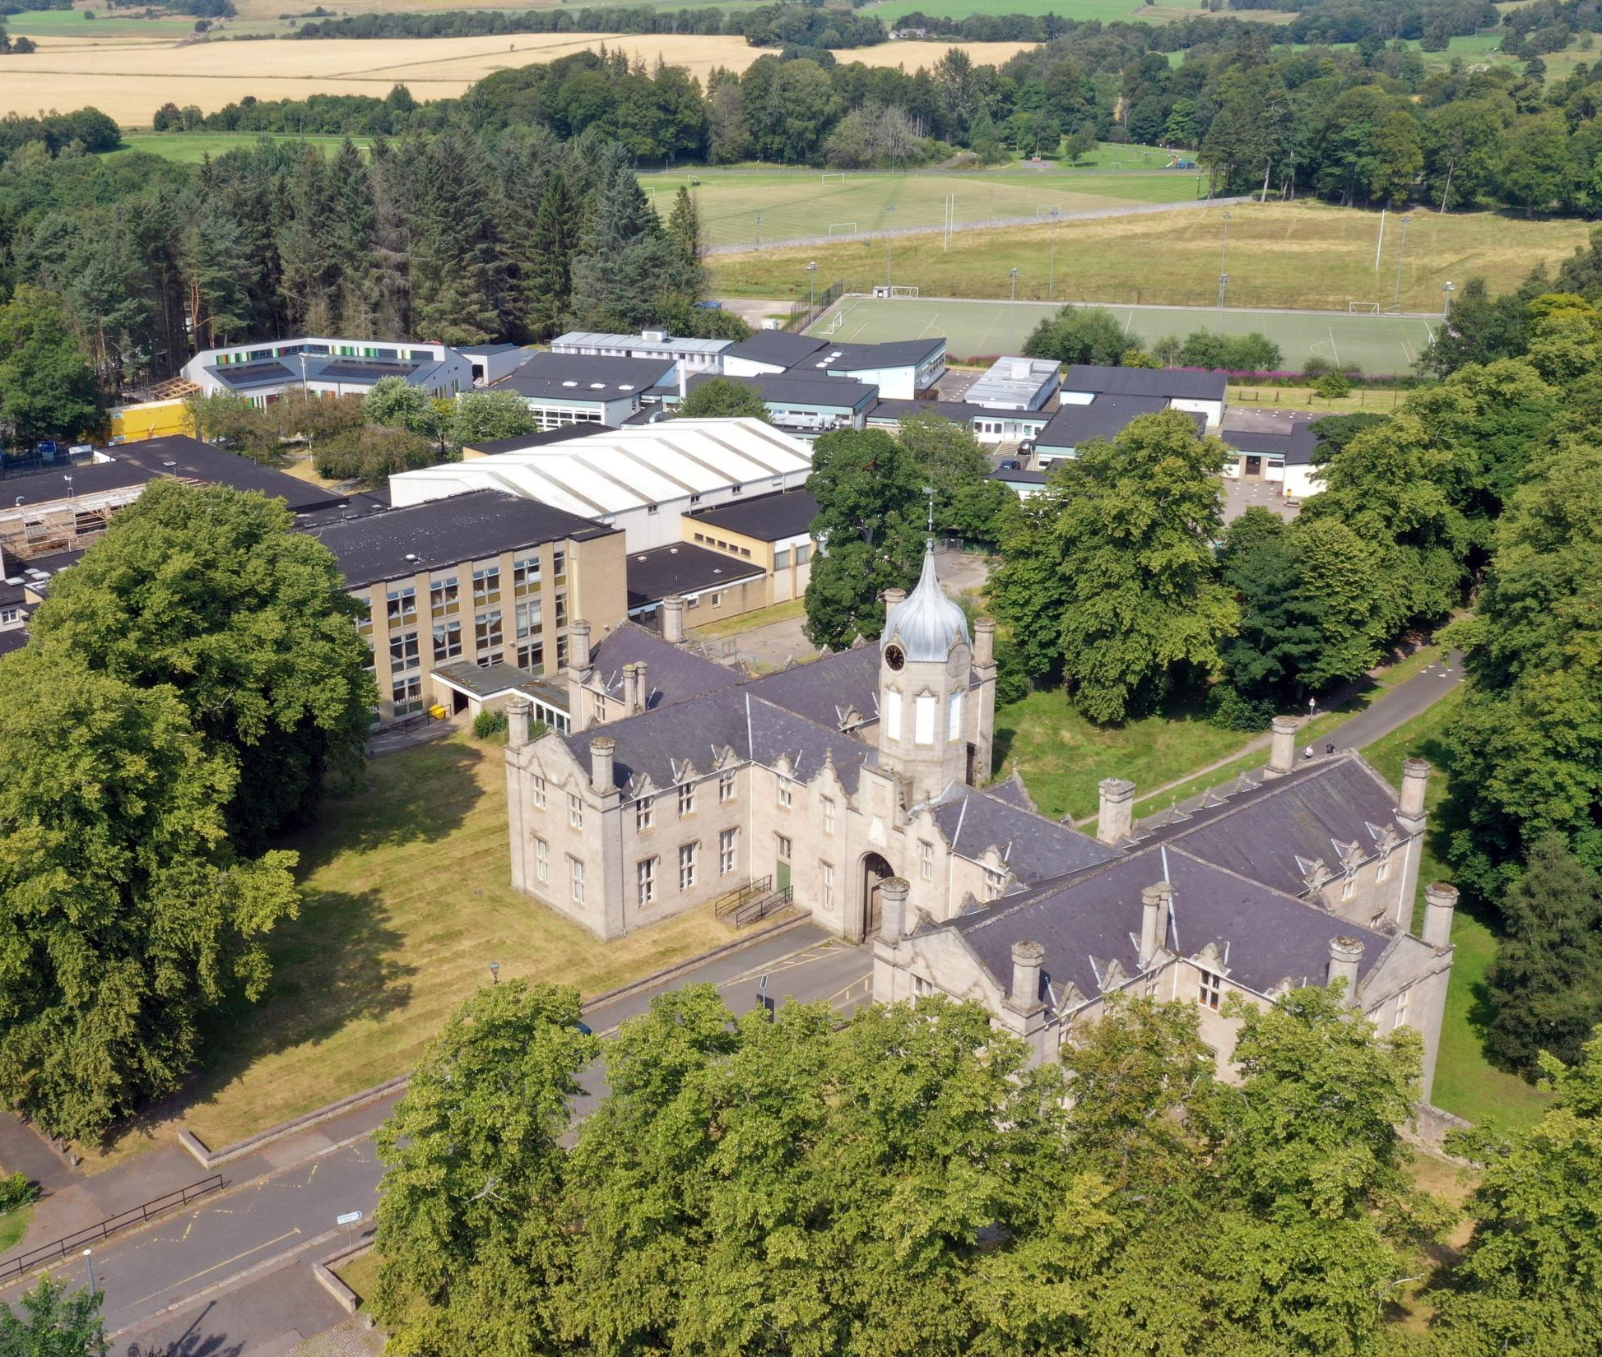
S4 & S5
Senior Phase:
Transition into
S5 & S6
Senior Phase Pathways
Curriculum Information
Presentation
February 2022

Slide 2
Welcome & Aims
To place transition within the context of our TGS Vision and reflect on our recent Attainment and progress
To give an outline of Curriculum for Excellence and confirm the rationale behind our transitions within the Senior Phase (S4 – S6)
To explore the pathways which lead our pupils to secure positive destinations
To give Parents/Carers the opportunity to ask any general questions around these transitions

Slide 3
TGS Vision | What we aspire to…
Together | We all feel included in our School community, local Huntly community and the north-east, national and global world. We consider the consequences our actions have on others and our wider environment.
Growing | We value and look after our physical, mental, emotional and spiritual health. TGS as a happy place with support where everyone can develop confidence and resilience for life in and beyond School.
Succeeding | Being the best possible version of yourself that you can be. Each individual learning and achieving as much as they can. Explore new things with a growth mind-set for future success.

Slide 4
A review of our attainment
Celebrating successes and
learning lessons
2016-2021

Slide 5
S4
We are measured on how many pupils in the S4 year group gain 5 or more Awards (A – D) at National 5 level:
2021 = 53.4%
2019 = 47.5%
2018 = 47%
2017 = 51%
2016 = 38%
TGS also has great success and celebrates pupils who gain SQA & other Awards at
National 1, 2, 3 and 4 levels.
2020 TGS National 5 Grades:
(these were awarded based on Teacher Professional Judgement)
Grade A Pass 248 / 39% Grade C Pass 160 / 25%
Grade B Pass 160 / 25% Grades A – D Awards 611 / 96%

Slide 6
S5
We are measured on how many pupils in the S5 year group gain 3 or more Awards (A – D) at Higher level:
2021 = 35%
2019 = 42%
2018 = 41%
2017 = 34%
2016 = 28%
In S5, we also have good success and celebrate pupils who gain further SQA and other Awards at
National 1, 2, 3 and 4 levels as well as Foundation Apprenticeships.
2020 TGS S5/6 Higher Grades:
(these were awarded based on Teacher Professional Judgement)
Grade A Pass 135 / 38% Grade C Pass 79 / 22%
Grade B Pass 98 / 28% Grades A – D Awards 342 / 96%

Slide 7
National Curriculum Structure
S1, 2, 3 – Broad General Education
(Skills & Knowledge development)
S4, 5, 6 – Senior Phase
(Certification – SQA and other Qualifications & Awards)
Positive (post-school) Destination(s)
Notes:
Linda

Slide 8
The Curriculum
The Curriculum is defined as the “totality of learners’ experiences both in and out of school”
Partnership working is key: e.g. NESCol
Senior Phase opportunities supporting each pupil’s learning pathway, e.g. Foundation Apprenticeships
Appropriate differentiation, support and challenge
Developing resilience, encouraging aspiration
S4/5/6 is for certification and ensuring Positive Leaver Destinations + Skills for learning, life & work

Slide 9
Curriculum for Excellence National Qualifications
SQA Qualifications in the Senior Phase:
Internally assessed by TGS -
SQA verify our standards
Externally assessed by SQA exams and coursework marks

Slide 11
Alternative SQA National Qualifications
There are also other qualifications at Levels 4, 5 & 6 which we are integrating into our curriculum in order to meet the needs of more learners.
Foundation Apprenticeships, at Level 4, 5 & 6, are included in our options – these combine study with work placement. They are being supported by Aberdeenshire Council and NESCol.
National Progression Awards at Levels 4, 5 & 6 (the same as National 4, 5 & Higher levels) which have no final exam, instead are continuously assessed throughout the year.

Slide 12
Options Process
Where to begin…?
Notes:
Dawn

Slide 13
Supporting Pupils to Achieve and Aspire
Team Game – Parents / Carers, Pupils, Community, Teachers & Support Colleagues, FHs, PTs & SLT
Stronger Attendance = Stronger Qualifications
“Hard work beats talent…
…when talent doesn’t work hard”
Resilience – be inspired to do better always
Maths and English – Literacy and Numeracy are key skills for all learning
Learning Conversations – Knowing where you are in your learning and next steps to improve

Slide 14
Transition from S4 into S5 & S6
Decisions
Enjoyment / Challenge / Interest
Strengths / Development needs
Skill sets & breadth vs depth
Future career paths
Advice of Teachers
Discussion with Parents / Carers
Progression Pathways
Support
TGS Tracking
Guidance Colleagues
My World of Work
My Kids Career
TGS Course outlines
Highers in a Nutshell
Skills Development Scotland (SDS) Advisor
It’s important that each individual pupil considers their decisions.
Friendship groups and Teachers may change over time.
Creating a pathway(s) that will bring you to your chosen
positive destination and / or having broad options to draw upon.
Notes:
Dawn

Slide 15
Progression Pathways
Expressive Arts example

Slide 16
Example of a TGS course descriptor
These can be accessed via the TGS website:
http://gordonschools.aberdeenshire.sch.uk/
Go to: Curriculum -
Course Choice
A one-page document summarising the benefits, skills, assessments, progression &
career pathways of that subject

Slide 17
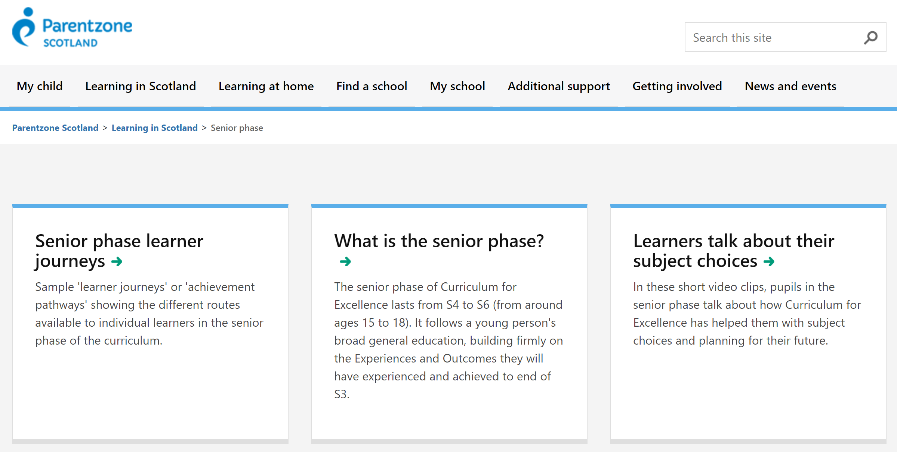
On the internet: Parentzone
https://education.gov.scot/parentzone/learning-in-scotland/senior-phase

Slide 18
My World of Work
https://www.myworldofwork.co.uk/my-career-options/choosing-my-subjects

Slide 19
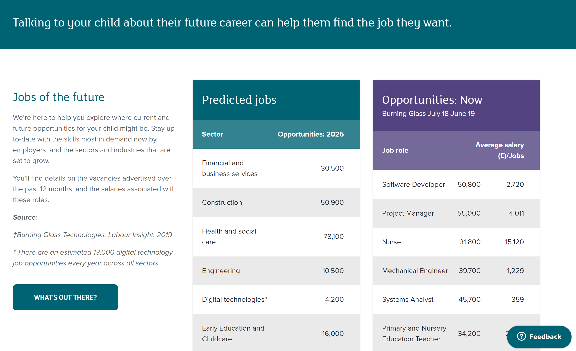
My Kid's Career
https://www.mykidscareer.com/

Slide 20
https://www.npfs.org.uk/downloads/category/in-a-nutshell-series/
nationals-in-a-nutshell-series/national-5/
https://www.npfs.org.uk/downloads/category/in-a-nutshell-series/nationals-in-a-nutshell-series/national-5/

Slide 21
What does S4/5/6 Senior Phase choice look like?
S4 (S5) (S6) | Option One L2 – L5 | Option Two L2 – L5 | Option Three L2 – L5 | Option Four L2 – L5 |  | Option Five L2 – L5 |  | Option Six L2 – L5 | PSE | RMPS | PE
S5 S6 | Option 1 Level 6 Higher (Adv) | Option 2 Level 6 Higher (Adv) | Option 3 Level 6 Higher (Adv) |  | Option 4 Level 6 Higher (Adv) |  | Option 5 Level 6 Higher (Adv) |  | PSE | PE elective | Elective
Year | Subject + Achievement combination
S4 | Maths & English + 4 Choices + Wider Achievement
S5 | 5 Subjects
S6 | 4 Subjects

Slide 22
Sample Form

Slide 23
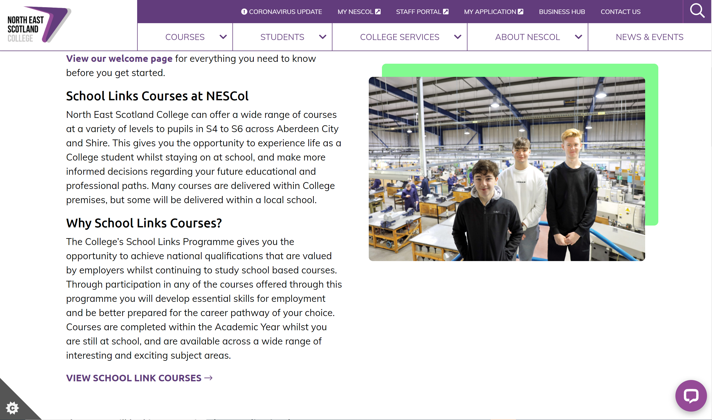
North East Scotland’s College: NESCol
School Link Courses
School Links - North East Scotland College (nescol.ac.uk)

Slide 24
Subject Areas include:
Digital Media
Civil Engineering
Construction
Automotive
Early Education and Childcare
Health Sector
Computing
Sport
Hospitality
Travel and Tourism
Marketing and Events
Psychology
Engineering
Accountancy
Laboratory Science
Beauty Therapy
Maritime
Those in bold are courses that have been taken by TGS pupils

Slide 25
Qualifications include:
SQA N5 and Higher
Skills for Work at N4 and N5
City and Guilds Awards
National Progression Awards
Foundation Apprenticeships
Professional Development Awards
College Certificates
TGS 2020-21: x pupils achieved
Awards at Levels 4, 5 & 6

Slide 26
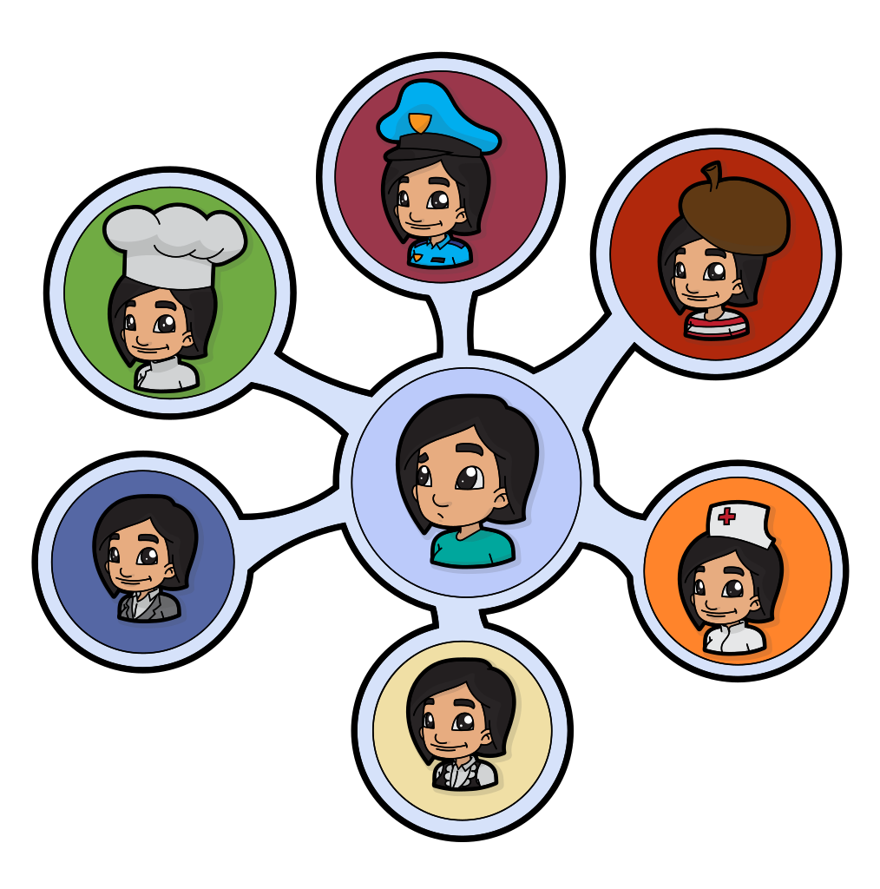
What is a foundation apprenticeship?
Foundation Apprenticeships

Slide 27
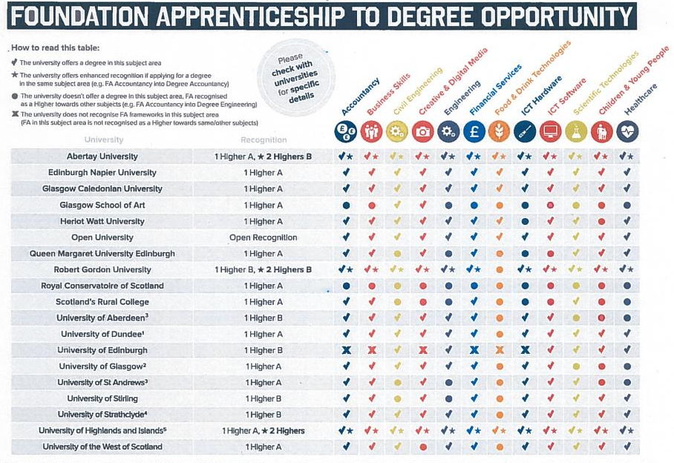

Slide 28
YASS
Young Applicants Scheme in Scotland
for S6 pupils
The Open University
TGS pupils in recent years have passes* in modules such as:
Understanding the autistic spectrum
Law in Scotland
Maths for science
The frozen planet
Living without oil: chemistry for a sustainable future
Galaxies, stars and planets
Molecules, medicines and drugs: a chemical story
* YASS courses do not carry UCAS points

Slide 29
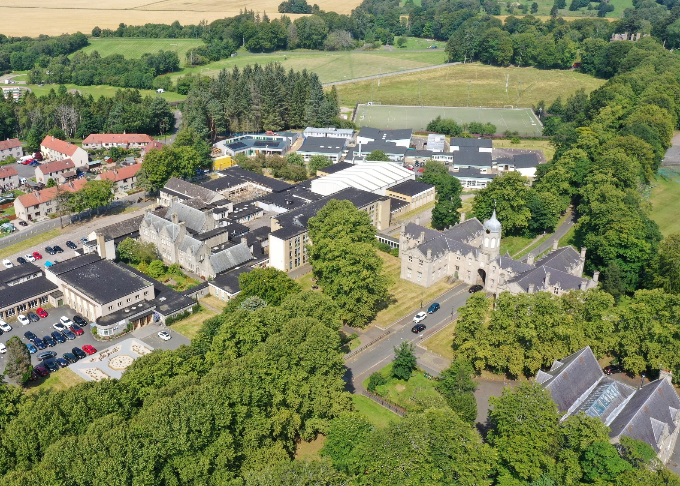
Your questions? gordonschools.aca@aberdeenshire.gov.uk

