Slide 1
The Scottish Wars of Independence
A family saga

Slide 2
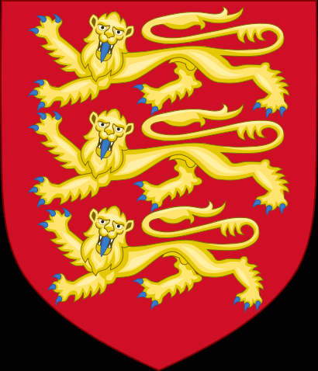
House of Plantagenet
House of Plantagenet
Arms of the Plantagenets
Had a mini Empire which included England, Wales, Ireland and Gascony ( a part of France).
Ruled quite strongly, but at times had to face opposition to their rule.
Edward I, perhaps one of its greatest kings, was feared, but introduced more laws and worked with a Parliament of nobles.

Slide 3
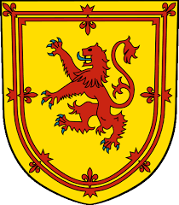
House of Dunkeld (or Canmore)
The house of Dunkeld…
Royal arms of Scotland
United Scotland (apart from the northern isles).
Stood up to English expansion.
Under Alexander II, even threatened English rule.

Slide 4
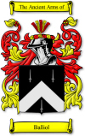
House of Balliol
The Balliols…
Balliol coat of arms
Were very wealthy – had lands in Scotland, England and France.
Established Balliol College at Oxford University.
Connected closely to the Royal line of Scotland.

Slide 5
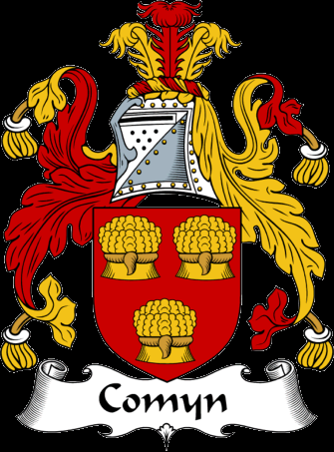
House of Comyn
The Comyns…
Comyn coat of arms
A very powerful family.
Connected to the Scottish Royal family.
Had lands in England and Scotland.
Their strongholds were in Badenoch and Banff and Buchan.

Slide 6
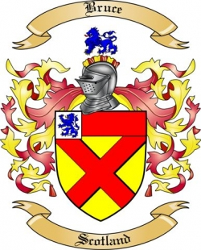
The Bruces
The Bruce family…
Had most of their lands in South West Scotland.
Had lands in Tottenham, now part of London.
A powerful family originally from Brux, in France.
Each eldest son was named Robert- there was an unbroken line of Robert Bruces until 1329.

Slide 7
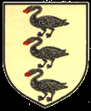
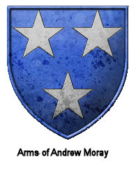
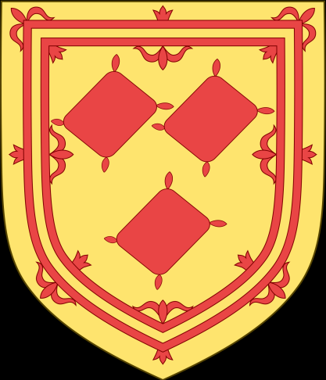
All noble families displayed their arms to show they were present at battles or important gatherings.
Other families…
Arms of Cressingham, de Moray and Randolph
Many other families were important, or made their names during our time.

Slide 8
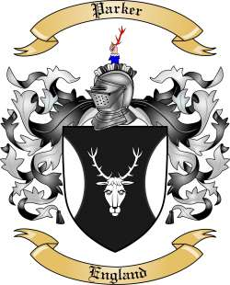
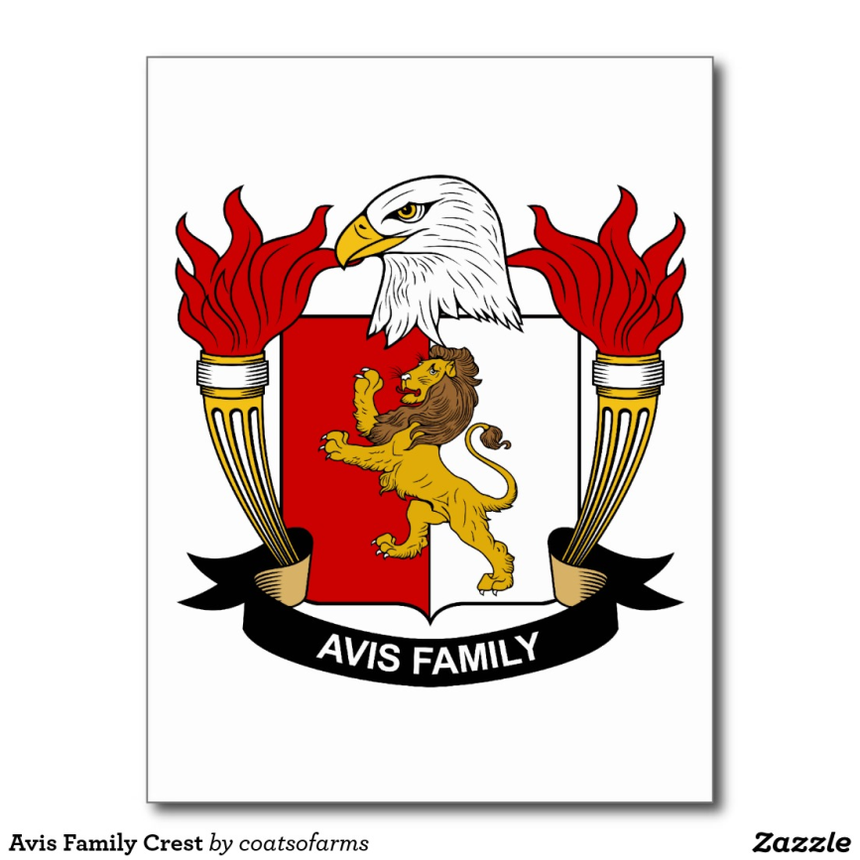
What is your coat of arms and motto?
The Avis coat of arms
The Parker coat of arms

