Slide 1
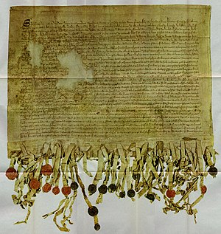
National 5 exam skills
Comparing two sources

Slide 2
How to do this question.
In this question, you must follow a clear technique.
You will be given two sources to compare. Read the sources carefully, including the rubrics (the short introductions).
You need to make two developed comparisons: find two pieces of information that either agree or disagree with each other.
The sources may fully or partially agree/disagree.
You need to judge how far they agree or disagree, making an overall comparison.

Slide 3
Template
The opening sentence.
You must make a judgement on how far the two sources agree or disagree.
Your judgement should look something like this, e.g.;
“Sources A and B agree to some extent about…”
“Sources A and B disagree to a great extent about…”

Slide 4
A developed comparison
You must find elements in the two sources which agree or disagree about the same thing.
You should structure your answer like this;
“Sources A and B agree about __________ . Source A tells us _____________ likewise source B tells us ______________ .” (if the sources are in agreement). OR…
“Sources A and B disagree about __________ . Source A tells us _____________ whereas source B tells us ______________ .” (if the sources are not in agreement).
It’s best to take direct quotes from the sources to gain the marks.

Slide 5
Make sure you make TWO developed comparisons.

Slide 6
Checklist: when you practice, make sure you have…
Written an opening statement judging how far the sources agree or disagree.
Written two clear developed comparisons, including what the sources agree or disagree on.
Used the correct linking words between your quotations: “likewise” if the two sources agree and “whereas” if the two sources disagree.

Slide 7
An example question…

Slide 8
An example answer
Sources B and C disagree to a great extent about the status of black Americans in the 1960s.
Sources B and C disagree on the progress black people had made. Source B says “We are no better off now than we were a hundred years ago” whereas Source C says “Black family incomes rose by 53 per cent”.
Sources B and C also disagree on the types of jobs black people were doing. Source B says “we are the janitors, the porters, the garbage men…” whereas source C says “black employment in professional, technical, and clerical occupations doubled”.
Therefore the sources disagree to a great extent.

