Slide 1
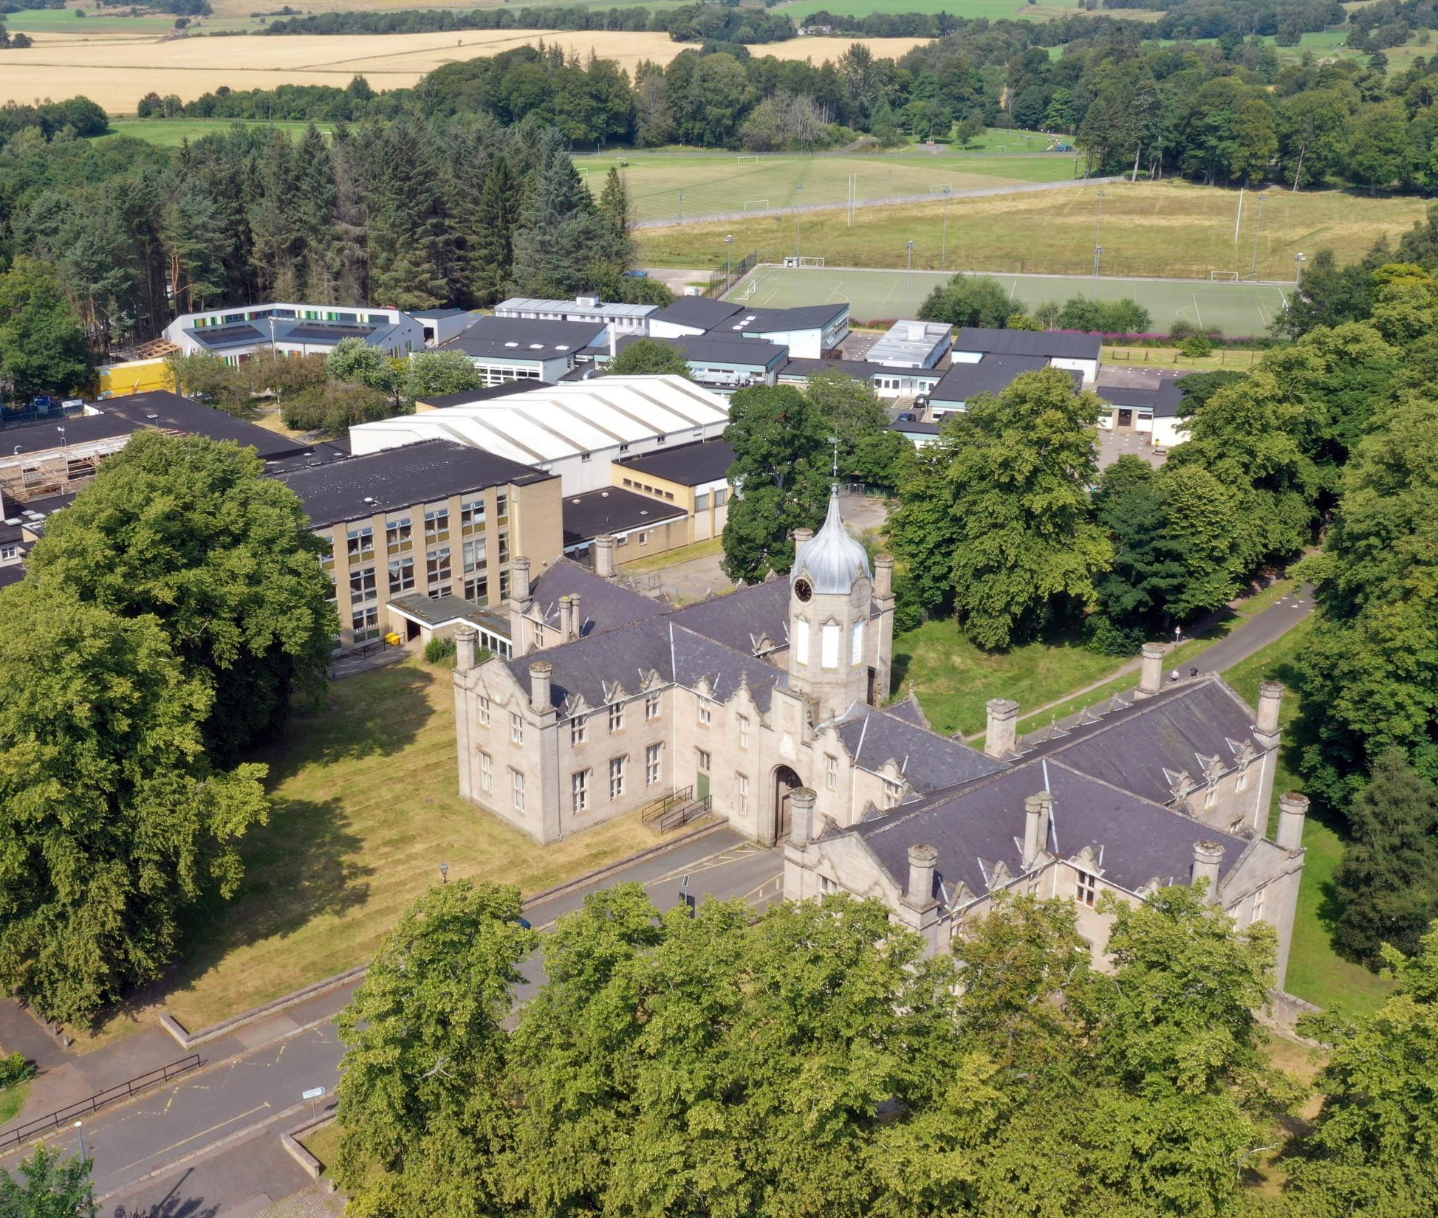
The Gordon Schools
S4 & S5
Transition into
S5 and S6
Senior Phase Pathways
Curriculum Information
Evening
12 January 2023

Slide 2
Welcome & Aims
To place transition within the context of our TGS Vision and reflect on our recent Attainment and progress
To give an outline of Curriculum for Excellence and confirm the rationale behind our transitions within the Senior Phase (S4 – S6)
To explore the pathways which lead our pupils to secure positive destinations
To give Parents/Carers the opportunity to ask any general questions around these transitions

Slide 3
TGS Vision | What we aspire to…
Together | We all feel included in our School community, local Huntly community and the north-east, national and global world. We consider the consequences our actions have on others and our wider environment.
Growing | We value and look after our physical, mental, emotional and spiritual health. TGS as a happy place with support where everyone can develop confidence and resilience for life in and beyond School.
Succeeding | Being the best possible version of yourself that you can be. Each individual learning and achieving as much as they can. Explore new things with a growth mind-set for future success.

Slide 4
A review of our attainment
Celebrating successes and
learning lessons
2019-2022

Slide 5
S4
We are measured on how many pupils in the S4 year group gain 5 or more Awards (A – D) at National 5 level:
2021-22 = 55.1%
2020-21* = 53.4%**
2019-20 = 56.1%*
2018-19 = 47.5%
TGS also has great success and celebrates pupils who gain SQA & other Awards at
National 1, 2, 3 and 4 levels.
2022 TGS National 5 Grades:
Grade A Pass 219 / 38% Grade C Pass 110 / 19%
Grade B Pass 165 / 29% Grade D Award s 65 / 11%
Grades A – D Awards 559 / 97%
2022 SQA Appeals at National 5: 18 successful = 6xA; 11xB; 1xC
* 2019-20 TGS gradings **2020-21 TGS exam paper and gradings

Slide 6
S5
We are measured on how many pupils in the S5 year group gain 3 or more Awards (A – D) at Higher level:
2021-22 = 43.6%
2020-21 = 35%**
2019-20 = 39.6%*
2018-19 = 42%
TGS also has great success and celebrates pupils who gain SQA & other Awards at National 1, 2, 3, 4 and 5 levels as well as Foundation Apprenticeships.
2022 TGS S5/6 Higher Grades:
Grade A Pass: 125 / 35% Grade D Award s 34 / 10%
Grade B Pass: 104 / 29% Grades A – D Awards 341 / 96%
Grade C Pass: 78 / 22%
2022 SQA Appeals at Higher: 14 successful = 8xA; 6xB
* 2019-20 TGS gradings **2020-21 TGS exam paper and gradings

Slide 7
National Curriculum Structure
S1, 2, 3: Broad General Education
(Skills & Knowledge development)
S4, 5, 6: Senior Phase
(Certification: SQA* and other Qualifications & Awards)
*2024-25 new qualifications body planned for Scotland
Positive (post-school) Destination(s)
Notes:
Linda

Slide 8
The Curriculum
The Curriculum is defined as the “totality of learners’ experiences both in and out of school”
Partnership working is key: e.g. NESCol & F.A.
Senior Phase opportunities which support each pupil’s learning pathway, e.g. Volunteering
Appropriate differentiation, support and challenge
Developing resilience, encouraging aspiration
S4/5/6 is for certification and ensuring Positive Leaver Destinations + Skills for learning, life & work

Slide 9
Curriculum for Excellence National Qualifications
SQA Qualifications in the Senior Phase:
Scotland’s National Qualifications
National 1
National 2
National 3
National 4
National 5
Higher
Advanced Higher
National 1 – National 4:
Internally assessed by TGS -
SQA verify our standards
National 5 – Advanced Higher:
Externally assessed by SQA exams and coursework marks

Slide 10
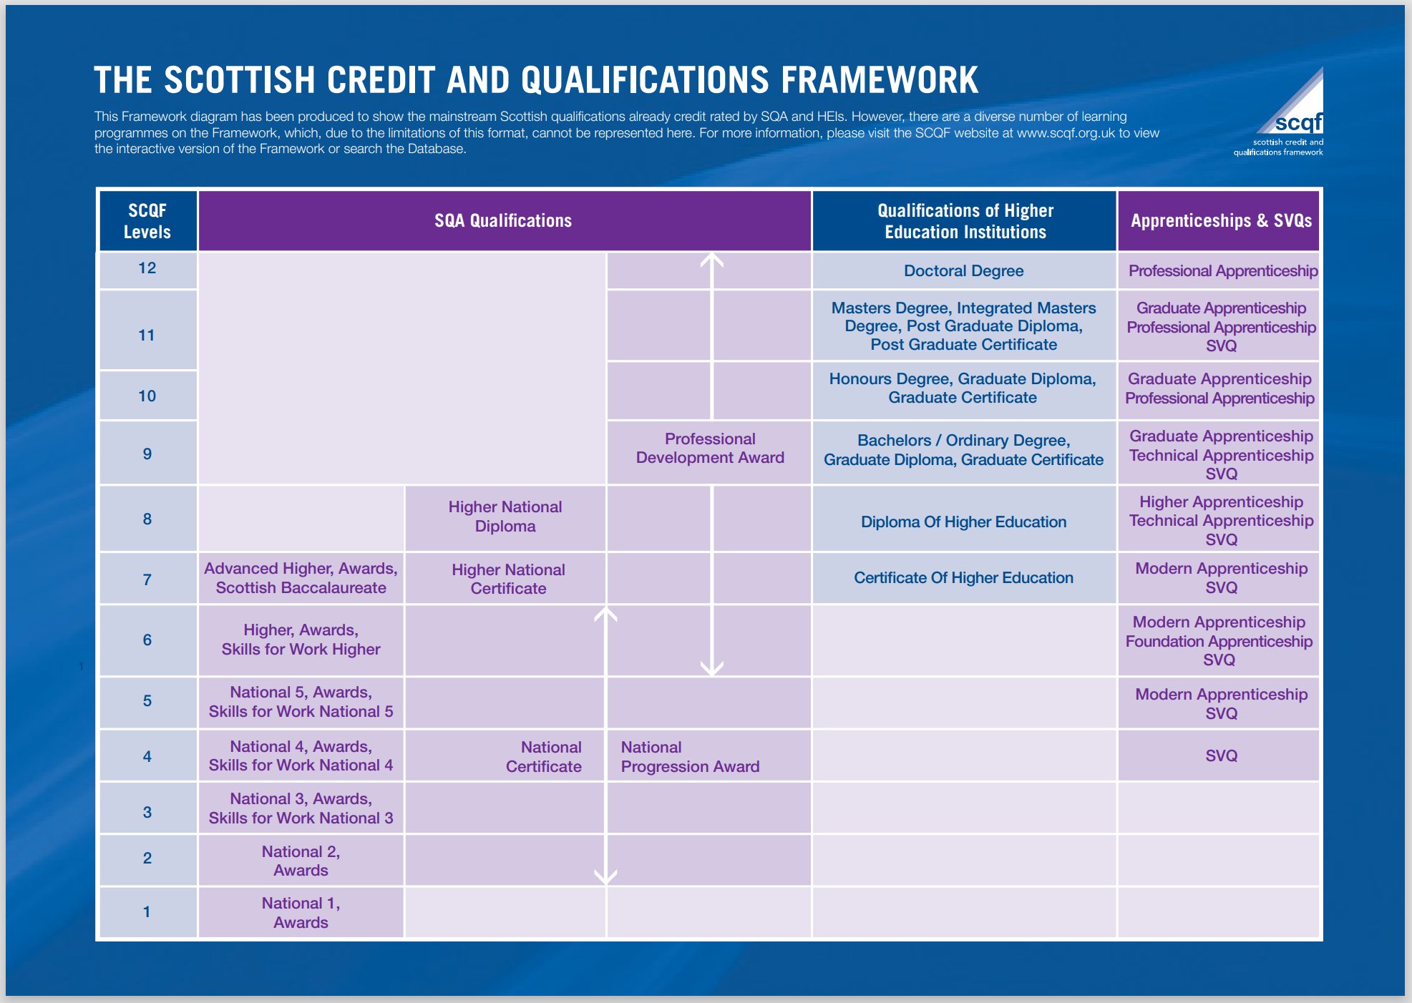

Slide 11
Options Process
Where next…?
Notes:
Dawn

Slide 12
Supporting Pupils to Achieve and Aspire
Team Game – Parents / Carers, Pupils, Community, Teachers & Support Colleagues, FHs, PTs & SLT
Stronger Attendance = Stronger Qualifications
“Hard work beats talent…
…when talent doesn’t work hard”
Resilience – be inspired to do better always
Maths and English – Literacy and Numeracy are key skills for all learning
Learning Conversations – Knowing where you are in your learning and next steps to improve

Slide 13
Transition from S4 into S5 & S6
Decisions
Enjoyment / Challenge / Interest
Strengths / Development needs
Skill sets & breadth vs depth
Future career aspirations
Advice of Teachers
Discussion with Parents / Carers
Progression Pathways
Support
Tracking Reports
Guidance Colleagues
My World of Work
My Kids Career
TGS Course outlines
Highers in a Nutshell
Skills Development Scotland (SDS) Advisor
Aspire and RGU
It’s important that each individual pupil considers their decisions.
Friendship groups and Teachers may change over time.
Creating a pathway(s) that will bring you to your chosen
positive destination and / or having broad options to draw upon.
Notes:
Dawn

Slide 14
Progression Pathways
Expressive Arts example

Slide 15
Example of a TGS course descriptor
These can be accessed via the TGS website:
http://gordonschools.aberdeenshire.sch.uk/
Go to: Parent Area - Transition
A one page document summarising the benefits, skills, assessments, progression &
career pathways of that subject

Slide 16
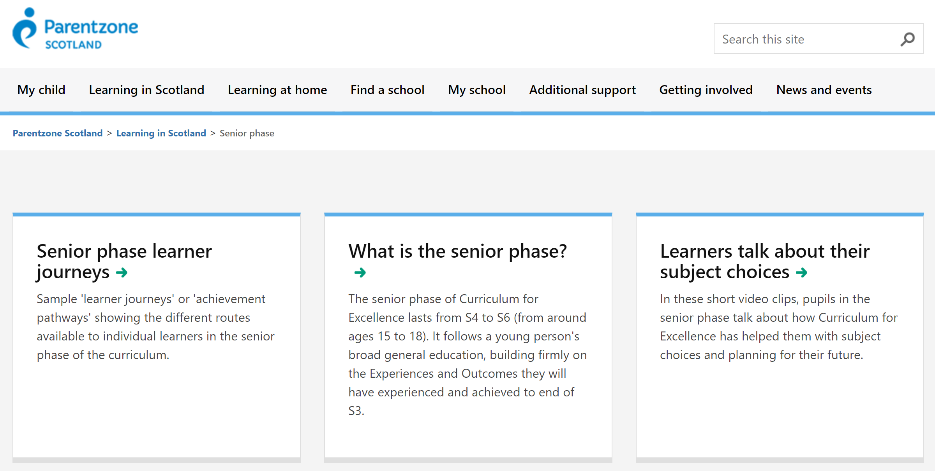
On the internet: Parentzone
https://education.gov.scot/parentzone/learning-in-scotland/senior-phase

Slide 17
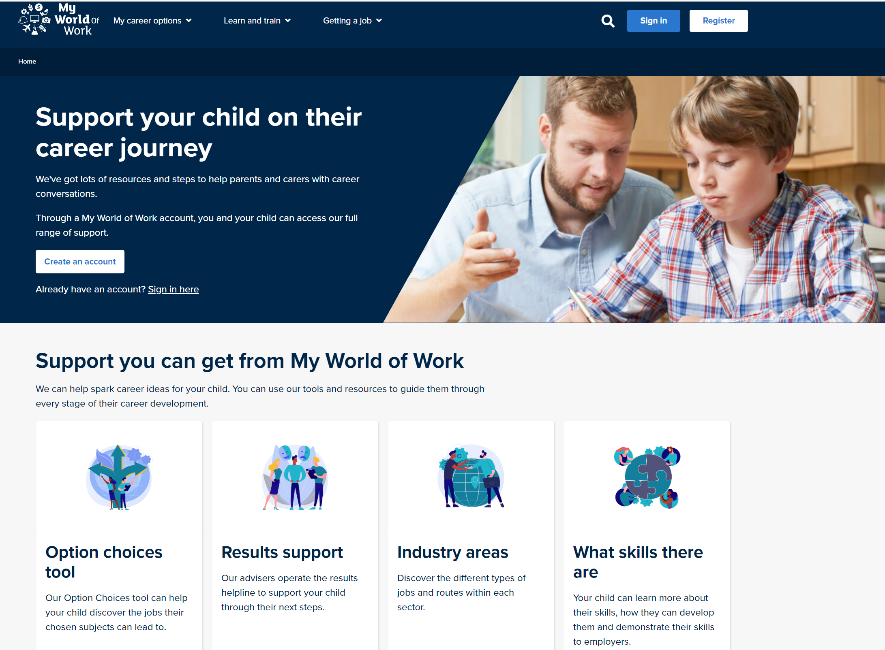
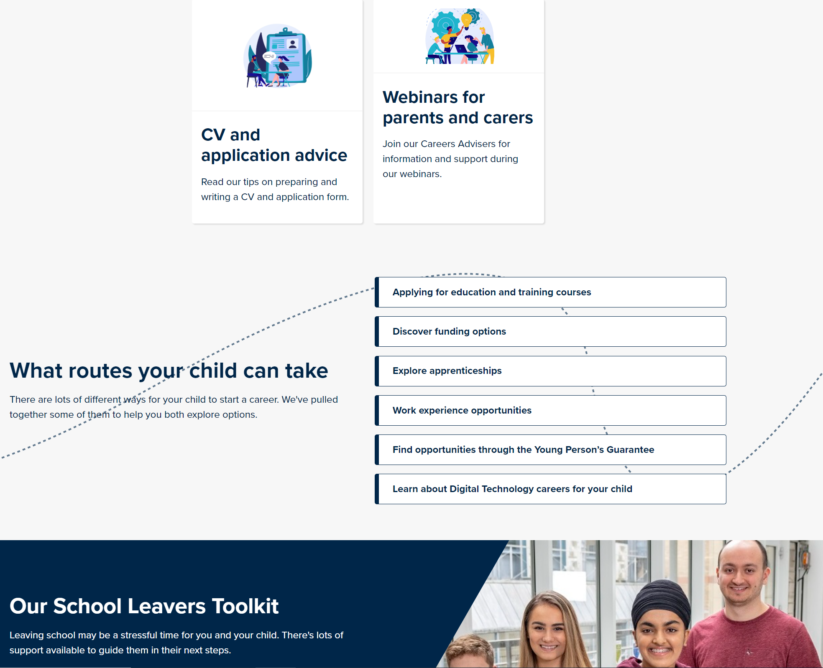
My World of Work
Supporting families
Skills Development Scotland
TGS support:
Lisa.OBrien@sds.co.uk

Slide 18
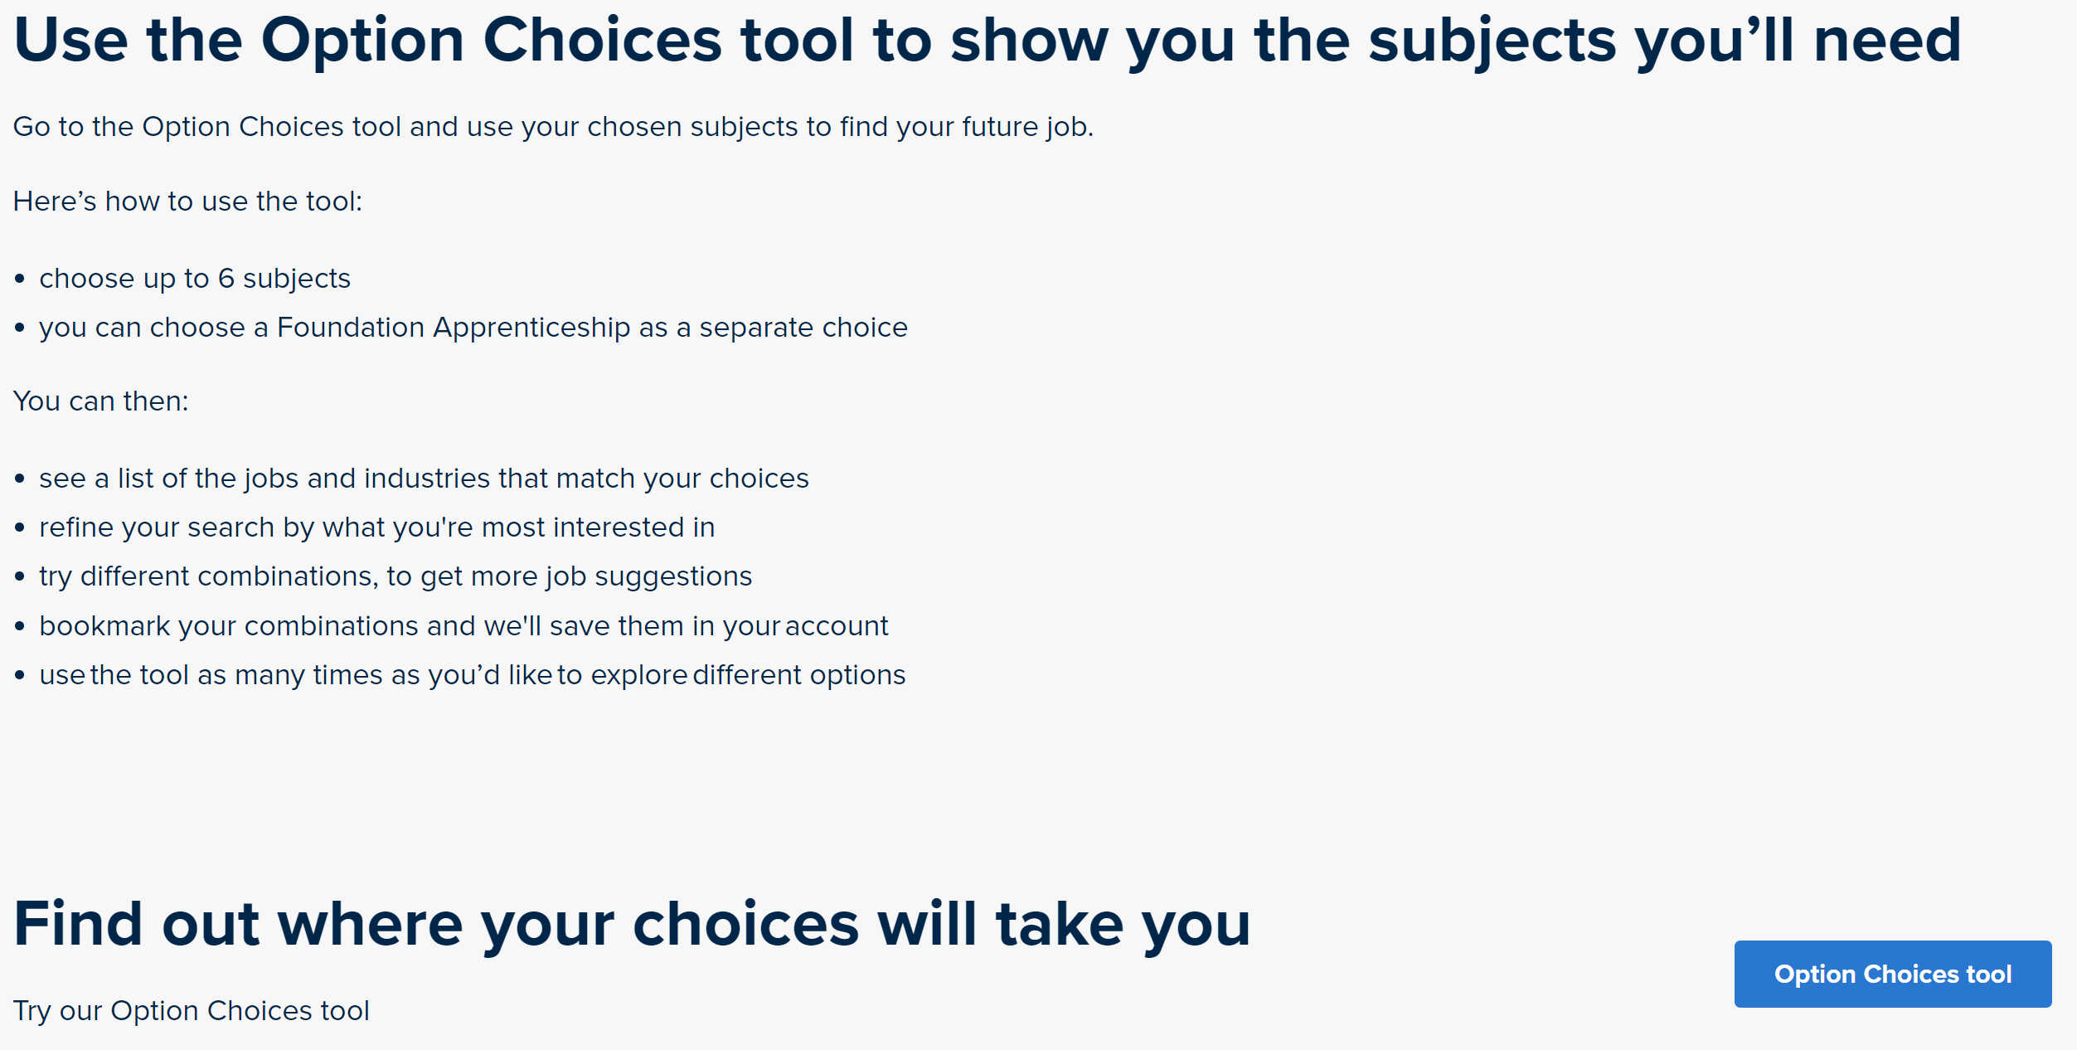
My World of Work:
https://www.myworldofwork.co.uk/my-career-options/choosing-my-subjects

Slide 19
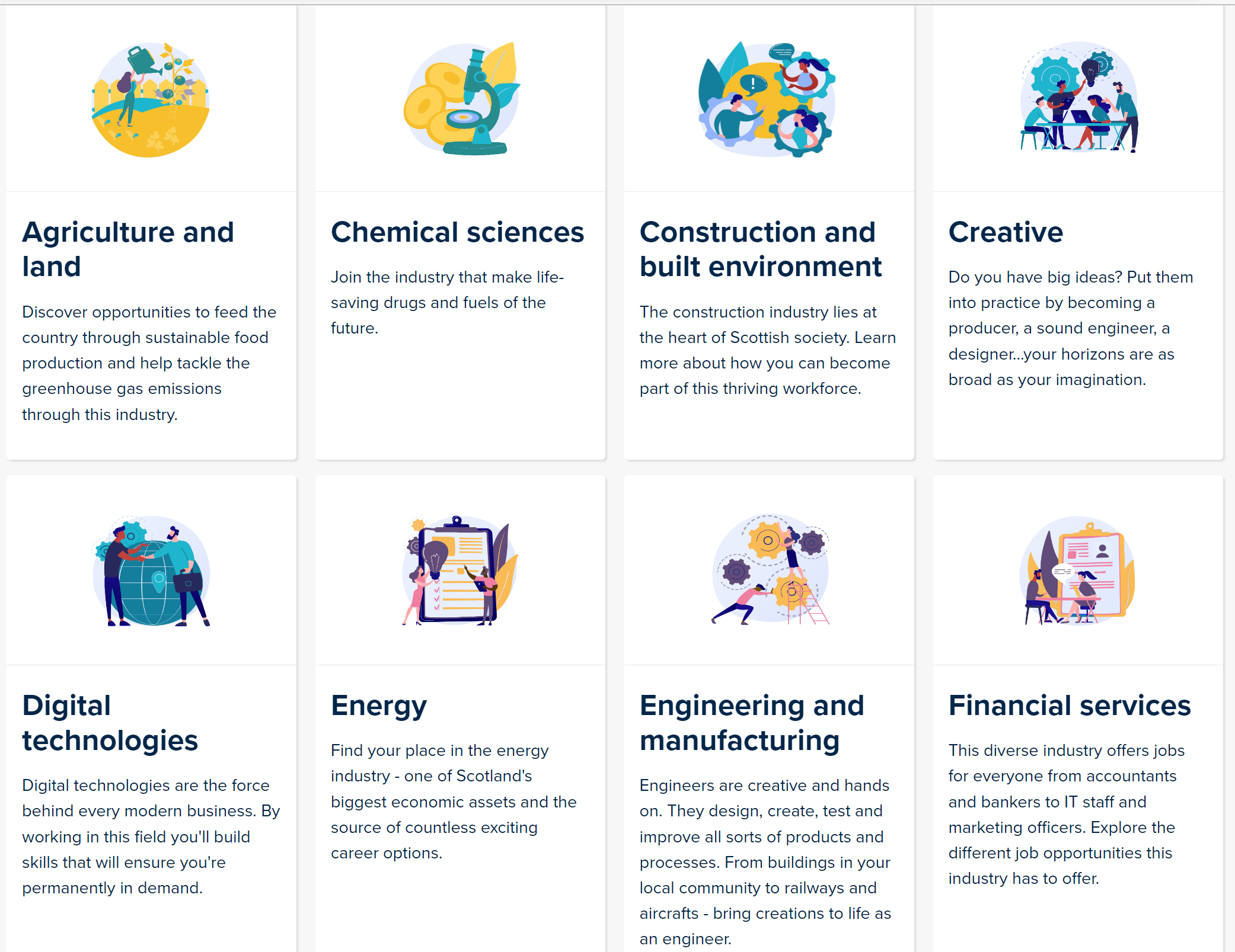
My Kid's Career:
https://www.mykidscareer.com/

Slide 20
Nationals-in-a-nutshell:
https://www.npfs.org.uk/downloads/category/in-a-nutshell-series/nationals-in-a-nutshell-series/national-5/

Slide 21
What does S4/5/6 Senior Phase choice look like?
S4 (S5) (S6) | Option One Levels 1 - 5 | Option Two Levels 1 - 5 | Option Three Levels 1 - 5 | Option Four Levels 1 - 5 |  | Option Five Levels 1 - 5 |  | Option Six Levels 1 - 5 | PSE | RMPS | PE
S5 S6 | Option 1 Level 6 Higher/ Adv H | Option 2 Level 6 Higher/ Adv H | Option 3 Level 6 Higher/ Adv H |  | Option 4 Level 6 Higher/ Adv H |  | Option 5 Level 6 Higher/ Adv H |  | PSE | PE elective | Elective
Year | Subjects + Other opportunities
S4 | Maths* & English + 4 Choices + Wider Achievement * 2 options: Mathematics or Applications of Mathematics
S5 | 5 Subjects minimum + Timetabled study
S6 | 4 Subjects minimum + whole-school contributions

Slide 22
The Course Choice Process
Pupils and families consider future pathways and destinations
Pupils and families consider the list of available subjects:
S5: Five subjects minimum
S6: Four subjects minimum
Ensure your child has an appropriate Literacy and Numeracy qualification that supports their intended post-School destination
Consider opportunities for personal development too
Two different reserve subjects are also needed
Complete initial paper form and discuss with Guidance Teacher
Complete on-line TOOLS form to confirm choices, priorities and reserve subjects together with future pathways ideas
Receive e-mail back confirming initial choices
Receive either confirmation of choices (may include Reserves) or
further discussion and re-choosing may be necessary

Slide 23
Alternative Qualifications
There are also other qualifications at Levels 4, 5 & 6 which we are integrating into our curriculum in order to meet the needs of more learners.
Foundation Apprenticeships at Level 6 (the same as Higher level), are included in our options – these combine study with work placement. They are being supported by Aberdeenshire Council and NESCOL.
National Progression Awards at Levels 4 & 5 (the same value as National 4 and 5 levels) which have no final exam, instead are continuously assessed throughout the year.
Currently offered in Administration, Computer Games Development and Photography.

Slide 24
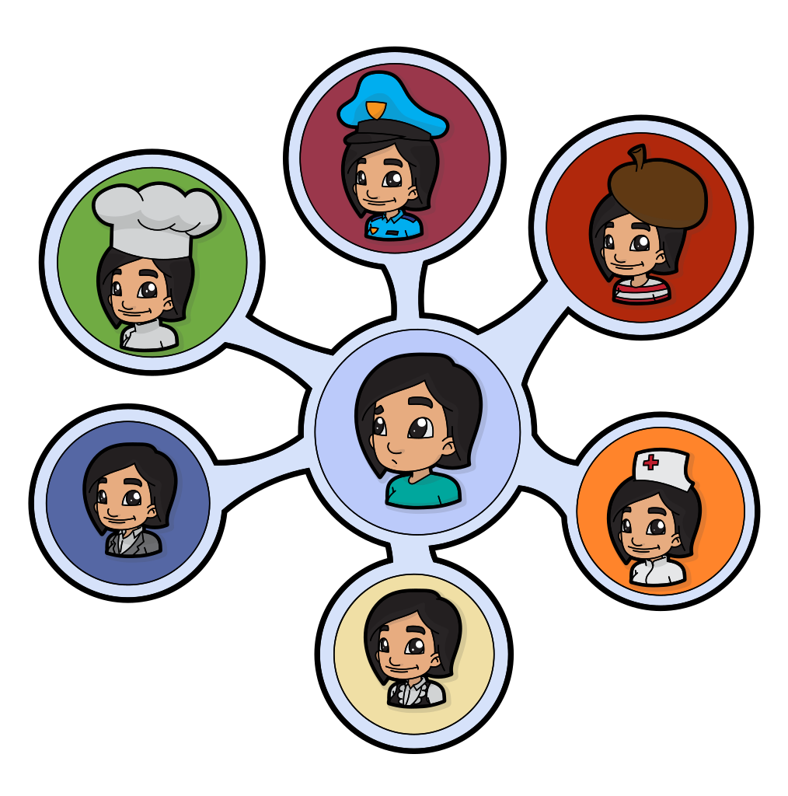
What is a foundation apprenticeship?
Foundation Apprenticeships
Here is Megan, S5, to tell you about her experience with the Health and Social Care Foundation Apprenticeship.

Slide 25
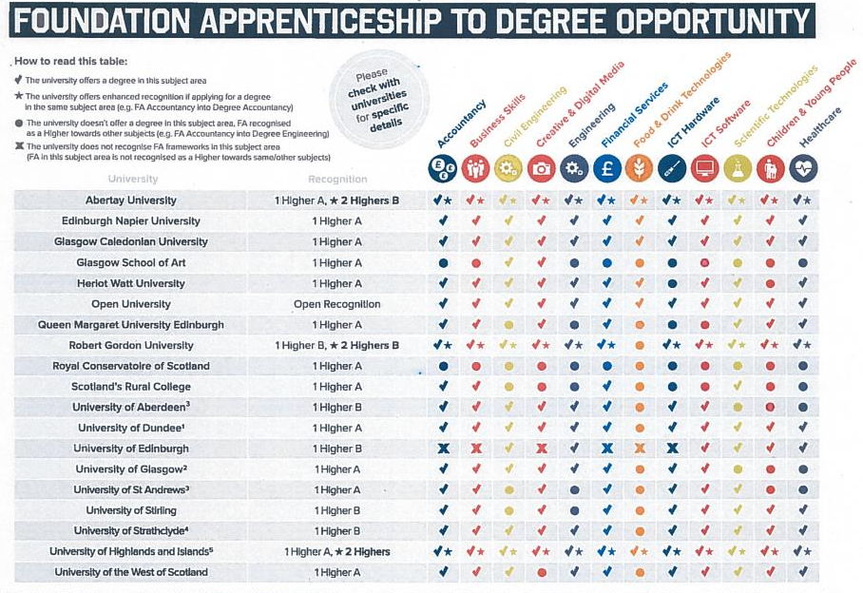

Slide 26
Foundation Apprenticeships at Level 4
S5/6 pupils have the opportunity to choose Foundation Apprenticeship:
Automotive
Construction
Working with a tutor; skills-based and; geared to industry work-based practice.
Luke: The Teacher is very supportive & approachable
Kyle: It gives you a lot of useful information about construction work
Daniel: It’s very good experience learning about different walls and how insulation is put in
Callum: If you like practical subjects, you will like Construction
Konan: The course gives you a lot of experience & is enjoyable

Slide 27
YASS
Young Applicants Scheme in Scotland
for S6 pupils
The Open University
TGS pupils in recent years have passes* in modules such as:
Understanding the autistic spectrum
Law in Scotland
Maths for science
The frozen planet
Living without oil: chemistry for a sustainable future
Galaxies, stars and planets
Molecules, medicines and drugs: a chemical story
* These do not carry UCAS points

Slide 28
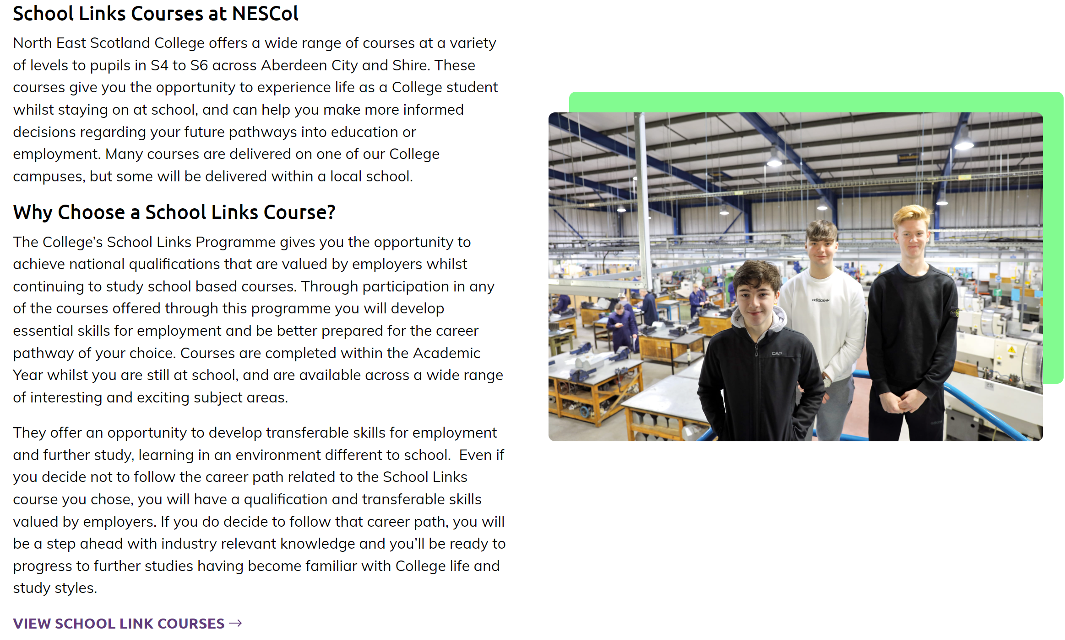
North East Scotland’s College: NESCol: School Link Courses
School Links - North East Scotland College (nescol.ac.uk)

Slide 29
School College Links
When being taught by a College lecturer young people will be treated like a College student.
College is an adult learning environment and we expect the same adult behaviour of school pupils as we do of our full time students.
College courses can mean missing some school classes – so additional commitment to catching up on missed work is essential
When attending a College course we expect pupils to behave as though they are arriving at work – on time and well prepared

Slide 30
School College Links Courses
College staff will report on pupil attendance, behaviour and progress to school
A written progress report for school and parents will be prepared twice a year
Courses are certificated and support progression to further study, modern apprenticeships, training or employment.
Courses support pupils in developing key skills identified by employers as essential for entering the workplace

Slide 31
Subject Areas include:
Digital Media
Civil Engineering
Construction
Automotive
Early Education and Childcare
Health Sector
Computing
Sport
Hospitality
Travel and Tourism
Marketing and Events
Psychology
Engineering
Accountancy
Laboratory Science
Beauty Therapy
Maritime
Those in bold are courses that have been taken by TGS pupils

Slide 32
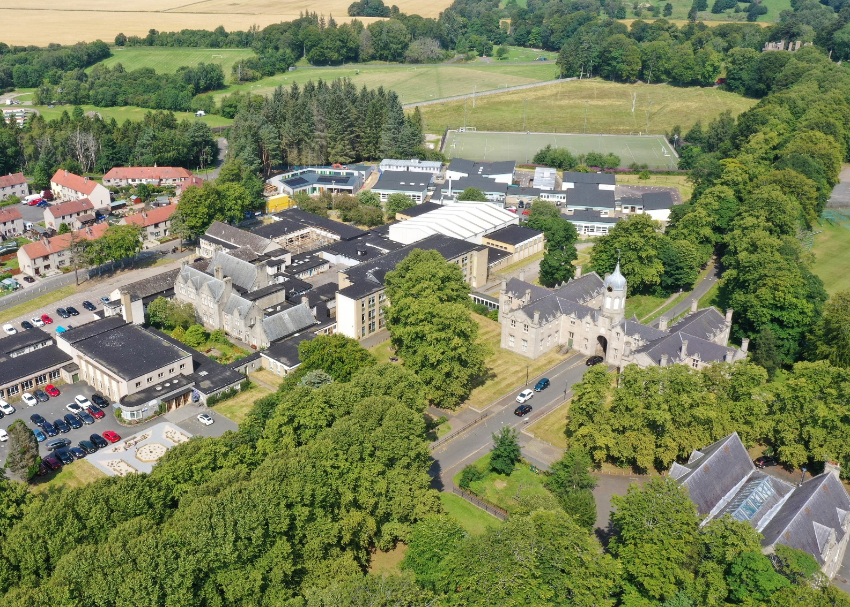
Any questions?

