Slide 1
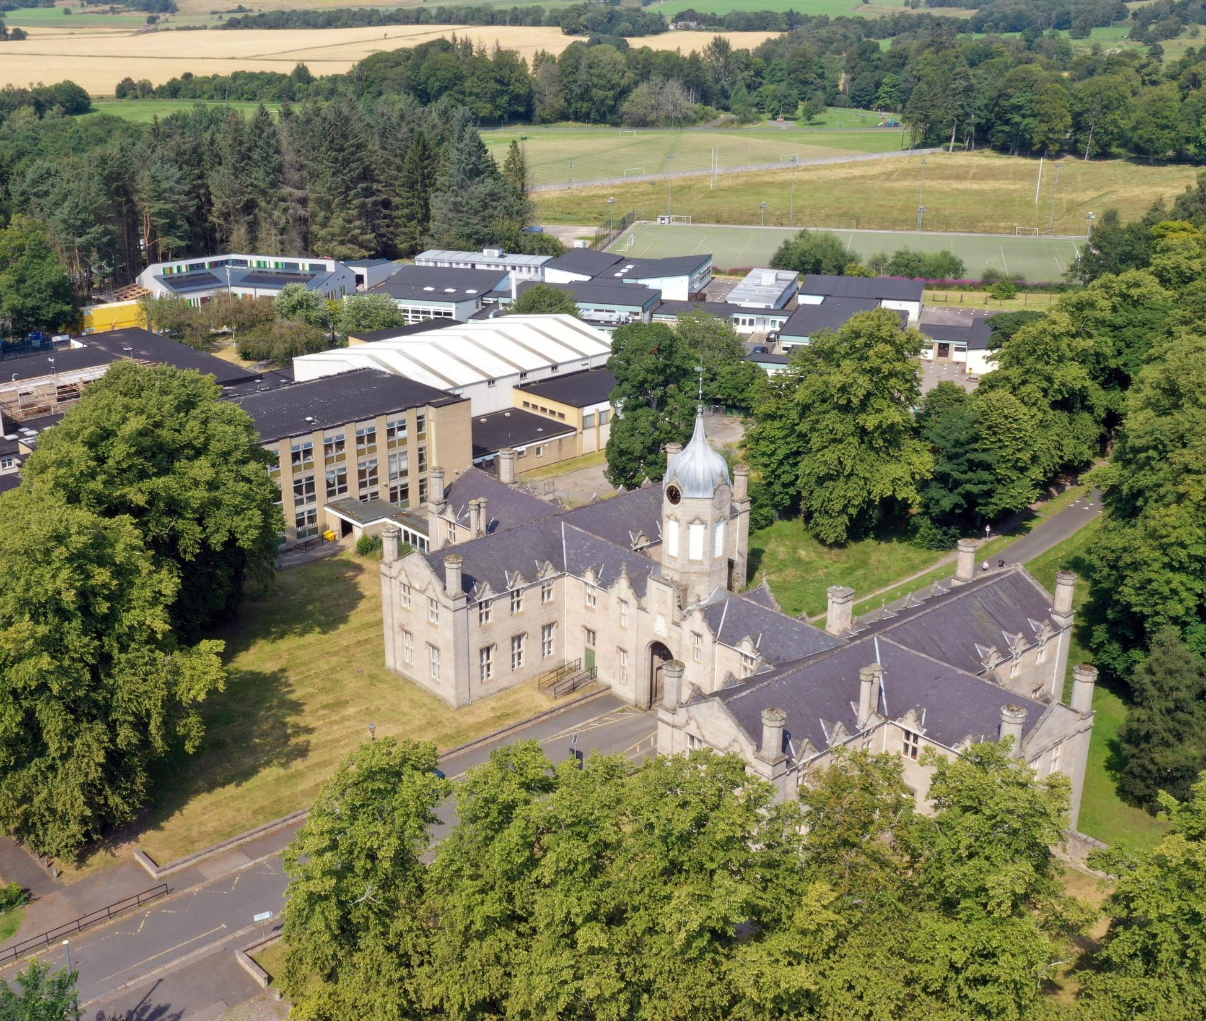
The Gordon Schools
S2 Broad General Education:
Personalising
the transition
into S3
Curriculum Information
Evening
February 2023

Slide 2
Welcome & Aims
To place transition within the context of our TGS Vision and reflect on our recent Attainment and progress
To give an outline of Curriculum for Excellence and confirm the rationale behind our transitions in the Broad General Education (S1 – S3)
To explore broad pathways which support our pupils to secure future positive destinations
To give Parents/Carers the opportunity to ask any general questions around this transition

Slide 3
TGS Vision | What we aspire to…
Together | We all feel included in our School community, local Huntly community and the north-east, national and global world. We consider the consequences our actions have on others and our wider environment.
Growing | We value and look after our physical, mental, emotional and spiritual health. TGS as a happy place with support where everyone can develop confidence and resilience for life in and beyond School.
Succeeding | Being the best possible version of yourself that you can be. Each individual learning and achieving as much as they can. Explore new things with a growth mind-set for future success.

Slide 4
National Curriculum Structure
S1, 2, 3: Broad General Education
(Skills & Knowledge development)
S4, 5, 6: Senior Phase
(Certification: SQA* and other Qualifications & Awards)
*2024-25 new qualifications body planned for Scotland
Positive (post-school) Destination(s)
Notes:
Linda

Slide 5
A review of our attainment
Celebrating successes and
learning lessons
2019-2022

Slide 6
S4
We are measured on how many pupils in the S4 year group gain 5 or more Awards (A – D) at National 5 level:
2021-22 = 55.1%
2020-21* = 53.4%**
2019-20 = 56.1%*
2018-19 = 47.5%
TGS also has great success and celebrates pupils who gain SQA & other Awards at
National 1, 2, 3 and 4 levels.
2022 TGS National 5 Grades:
Grade A Pass 219 / 38% Grade C Pass 110 / 19%
Grade B Pass 165 / 29% Grade D Award s 65 / 11%
Grades A – D Awards 559 / 97%
* 2019-20 TGS gradings **2020-21 TGS exam paper and gradings

Slide 7
S5
We are measured on how many pupils in the S5 year group gain 3 or more Awards (A – D) at Higher level:
2021-22 = 43.6%
2020-21 = 35%**
2019-20 = 39.6%*
2018-19 = 42%
TGS also has great success and celebrates pupils who gain SQA & other Awards at National 1, 2, 3, 4 and 5 levels as well as Foundation Apprenticeships.
2022 TGS S5/6 Higher Grades:
Grade A Pass: 125 / 35% Grade D Award s 34 / 10%
Grade B Pass: 104 / 29% Grades A – D Awards 341 / 96%
Grade C Pass: 78 / 22%
* 2019-20 TGS gradings **2020-21 TGS exam paper and gradings

Slide 8
The Curriculum
The Curriculum is defined as the “totality of learners’ experiences both in and out of school”
Partnership working is key: e.g. Gordon Rural Action & Aberdeen Football Club Community Trust
Opportunities which support each pupil’s wider learning pathway, e.g. Pupil Council, Sports Committee
Appropriate differentiation, support and challenge
Developing resilience, encouraging aspiration
S1/2/3 for skills, knowledge and broad pathways
S4/5/6 for certification & positive destinations

Slide 9
Options Process
Where to begin…?
Notes:
Dawn

Slide 10
Supporting Pupils to Achieve and Aspire
Team Game – Parents / Carers, Pupils, Community, Teachers & Support Colleagues, FHs, PTs & SLT
Stronger Attendance = Stronger Qualifications
“Hard work beats talent…
…when talent doesn’t work hard”
Resilience: be inspired to do better always
Literacy and Numeracy are key skills for all learning
Learning Conversations: knowing where you are in your learning and next steps to improve

Slide 11
Transition from S2 into S3
Decisions
Enjoyment / Challenge / Interest
Strengths / Development needs
Skill sets
Future career paths
Advice of Teachers
Discussion with Parents / Carers
Progression Pathways
Support
Tracking & Full Reports
Guidance Colleagues
‘My World of Work’
‘My Kids Career’
TGS Course outlines
Skills Development Scotland (SDS) Advisor
Current S3 pupils
It’s important that each individual pupil considers their decisions.
Friendship groups and Teachers may change over time.
Creating a pathway(s) that will bring you to your chosen
positive destination and / or having broad options to draw upon.
Notes:
3Dawn

Slide 12
Example of a TGS course descriptor
These can be accessed via the TGS website:
Course choice information (gordonschools.aberdeenshire.sch.uk)
Go to: Curriculum – Course Choice
A one page document summarising the benefits, skills, assessments, progression &
career pathways of that subject

Slide 13
S3 Options
Personalising from the
Curriculum Areas,
including reserve subjects in some curriculum areas
Notes:
Dawn

Slide 14
Progression Pathways
Expressive Arts example

Slide 15
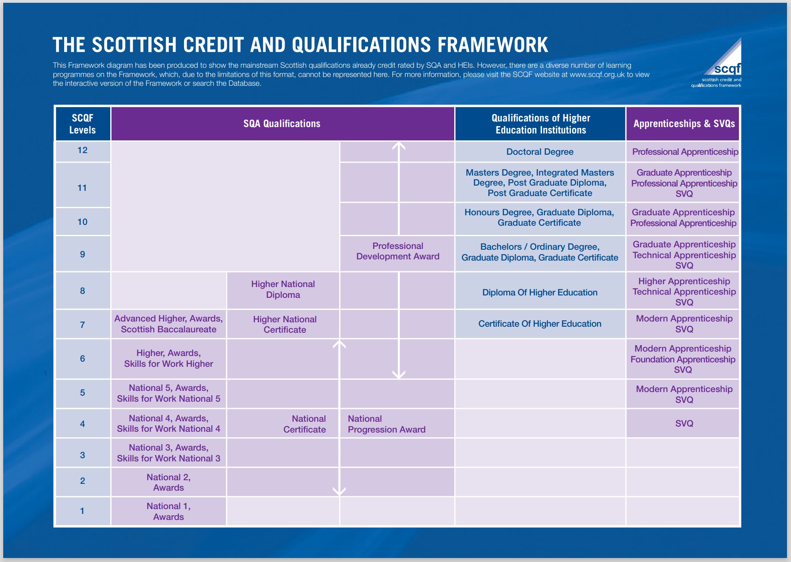

Slide 16
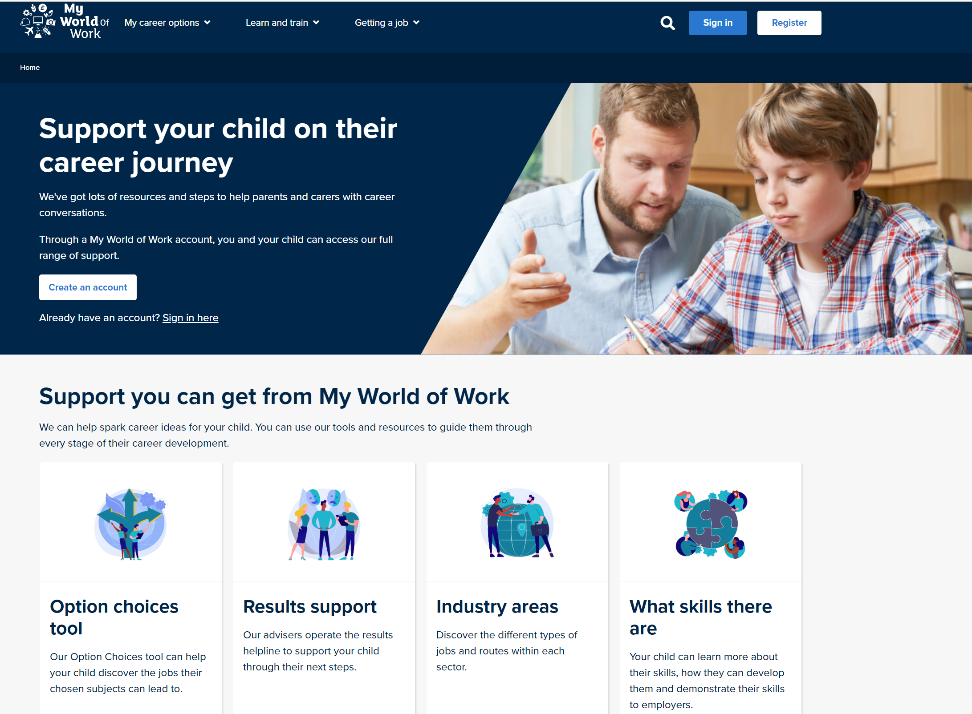
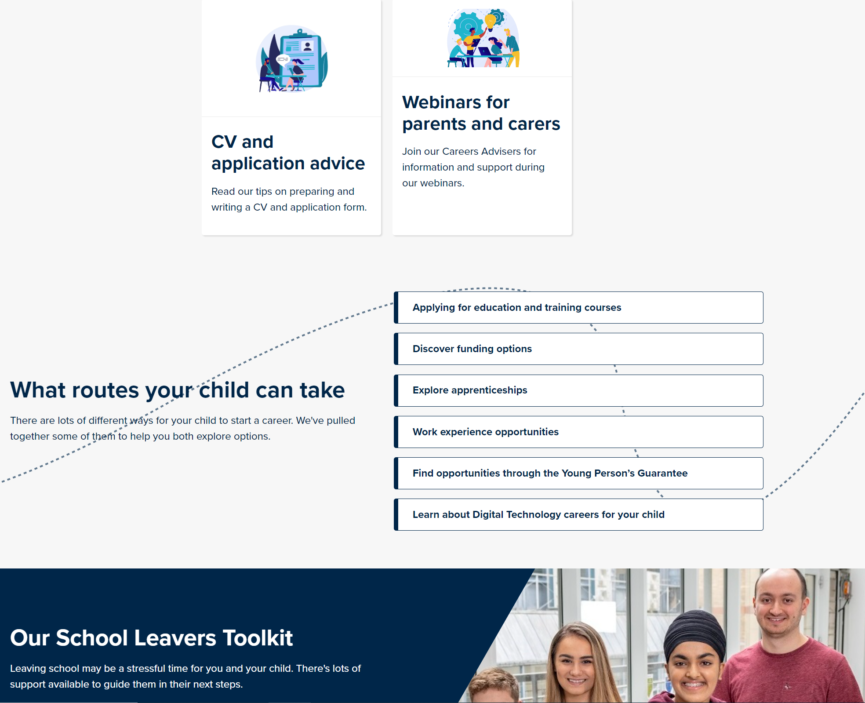
My World of Work
Supporting families
Skills Development Scotland
TGS support:
Lisa.OBrien@sds.co.uk

Slide 17
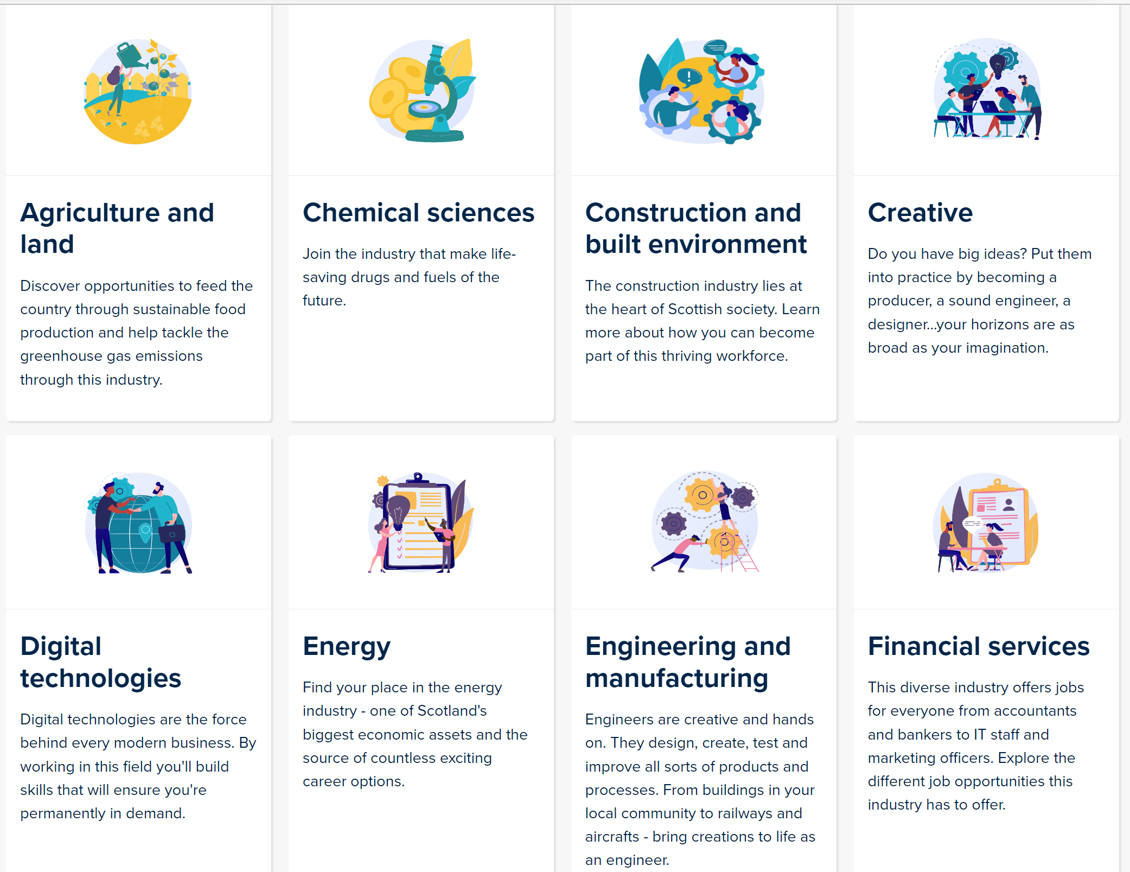
My Kid's Career:
https://www.mykidscareer.com/

Slide 18
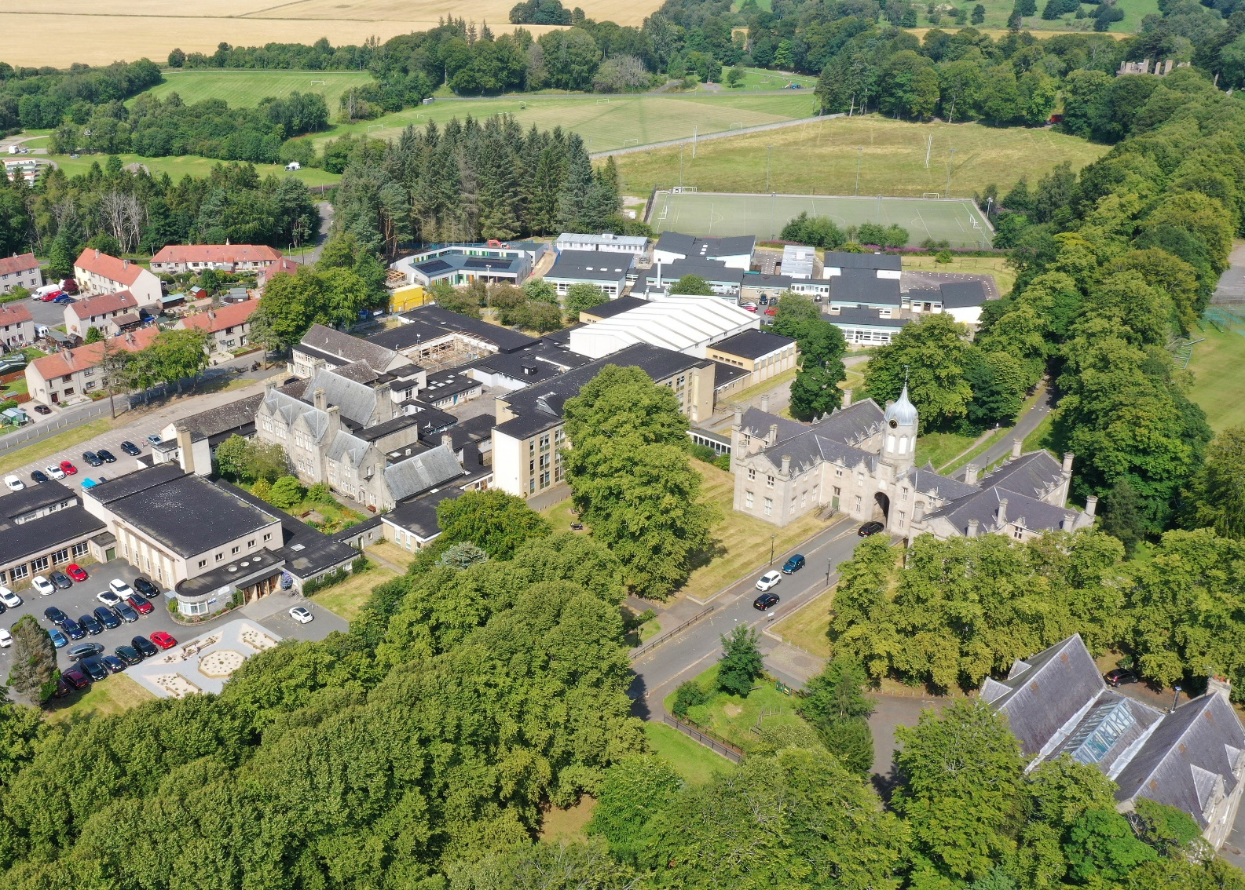
Your questions? gordonschools.aca@aberdeenshire.gov.uk

