Slide 1
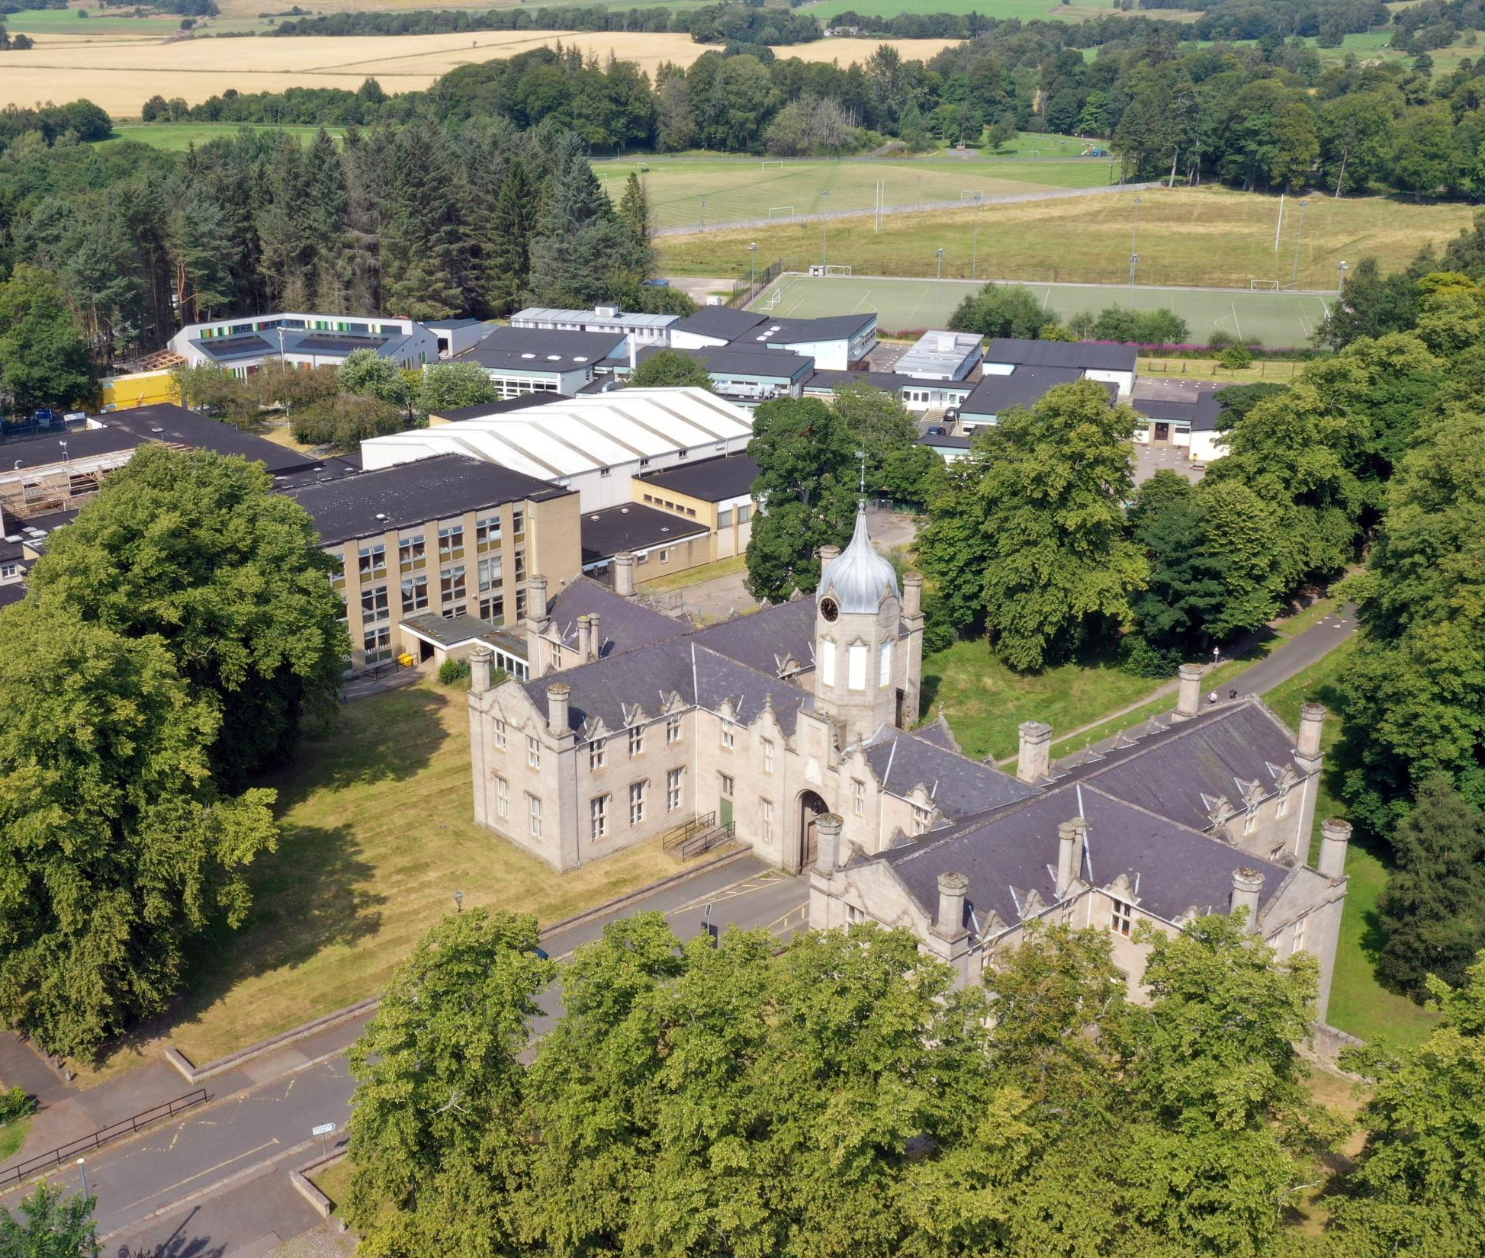
The Gordon Schools
S4 Transition
into S5
Senior Phase Pathways
February 2023

Slide 2
TGS Vision | Your personalisation:
Together | Learning in our School Learning in our community Follow the timeline so that everyone else is able to do their job at the right time
Growing | Having responsibility to make more decisions about your learning TGS will support you with your choices
Succeeding | Giving yourself the best chance to start you own future learning pathway Exploring new things with a growth mind-set for future success.

Slide 3
Curriculum for Excellence National Qualifications
SQA Qualifications in the Senior Phase:
Scotland’s National Qualifications
National 1
National 2
National 3
National 4
National 5
Higher
Advanced Higher
National 1 – National 4:
Internally assessed by TGS -
SQA verify our standards
National 5 – Advanced Higher:
Externally assessed by SQA exams and coursework marks

Slide 4
Transition from S4 into S5
Decisions
Enjoyment / Challenge / Interest
Strengths / Development needs
Skill sets & breadth vs depth
Future career aspirations
Advice of Teachers
Discussion with Parents / Carers
Progression Pathways
Support
Tracking Reports
Guidance Colleagues
My World of Work
My Kids Career
TGS Course outlines
Highers in a Nutshell
Skills Development Scotland (SDS) Advisor
Aspire and RGU
It’s important that each individual pupil considers their decisions.
Friendship groups and Teachers may change over time.
Creating a pathway(s) that will bring you to your chosen
positive destination and / or having broad options to draw upon.
Notes:
Dawn

Slide 5
Options Process
Where next…?
Notes:
Dawn

Slide 6
Example of a TGS course descriptor
These can be accessed via the TGS website:
Course choice information (gordonschools.aberdeenshire.sch.uk)
Go to: Curriculum – Course Choice
A one page document summarising the benefits, skills, assessments, progression &
career pathways of that subject

Slide 7
Progression Pathways
Expressive Arts example

Slide 8
What does S4/5/6 Senior Phase choice look like?
S4 (S5) (S6) | Option One Levels 1 - 5 | Option Two Levels 1 - 5 | Option Three Levels 1 - 5 | Option Four Levels 1 - 5 |  | Option Five Levels 1 - 5 |  | Option Six Levels 1 - 5 | PSE | RMPS | PE
S5 S6 | Option 1 Level 6 Higher/ Adv H | Option 2 Level 6 Higher/ Adv H | Option 3 Level 6 Higher/ Adv H |  | Option 4 Level 6 Higher/ Adv H |  | Option 5 Level 6 Higher/ Adv H |  | PSE | STUDY | WA/ VOL
Year | Subjects + Other opportunities
S4 | Maths* & English + 4 Choices + Wider Achievement * 2 options: Mathematics or Applications of Mathematics
S5 | 5 Subjects minimum + Timetabled study
S6 | 4 Subjects minimum + whole-school contributions

Slide 9
The Course Choice Process
Pupils and families consider future pathways and destinations
Pupils and families consider the list of available subjects:
S5: Five subjects minimum
S6: Four subjects minimum
Ensure your child has an appropriate Literacy and Numeracy qualification that supports their intended post-School destination
Consider opportunities for personal development too
Two different reserve subjects are also needed
Complete initial paper form and discuss with Guidance Teacher
Complete on-line TOOLS form to confirm choices, priorities and reserve subjects together with future pathways ideas
Receive e-mail back confirming initial choices
Receive either confirmation of choices (may include Reserves) or
further discussion and re-choosing may be necessary

Slide 10
National Courses: SCQF Levels 3 - 5
Administration (NPA option)
Applications of Maths
Art and Design
Biology
Business Management
Chemistry
Computer Games Development NPA
Drama
Economics
English
French
Geography
German
Graphic Communication
History
Maths
Modern Studies
Music
Music Technology
P.E.
People in Society
Photography NPA
Physics
Practical Cookery
Prince’s Trust
Spanish
Science and Health Level 4 NPA
Foundation Apprenticeships
Automotive Level 4 FA
Construction 4 FA
S5 | Choice 1 | Choice 2 | Choice 3 | Choice 4 | Choice 5 | 2 Reserve subjects

Slide 11
National Courses: SCQF Levels 6
(Level 7 availability indicated in brackets)
Accounts
Administration
Art and Design (7)
Biology (7)
Business Management
Chemistry (7)
Drama (7)
Economics
English (7)
French (7)
Geography (7)
German (7)
Graphic Communication
History (7)
Human Biology
Maths (7)
Modern Studies (7)
Music (7)
P.E.
Photography
Physics (7)
Spanish (7)
Foundation Apprenticeships
Accountancy
Creative & Digital Media
Food and Drink Technologies
Social Services Children & Young People
Social Services & Health Care

Slide 12
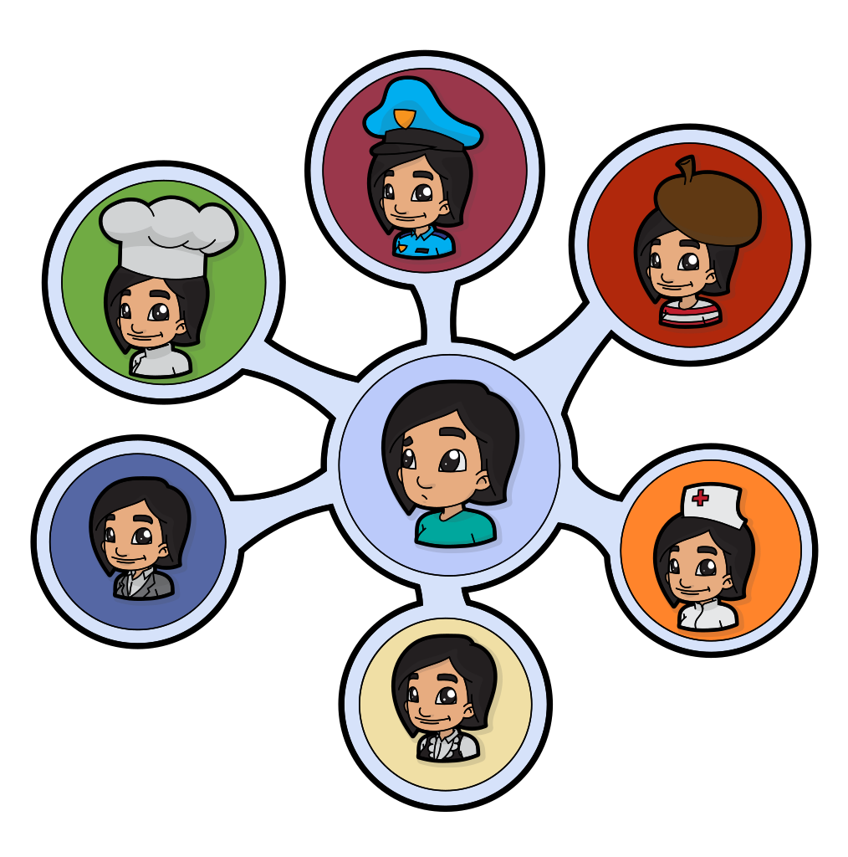
What is a foundation apprenticeship?
Foundation Apprenticeships
Here is Megan, S5, to tell you about her experience with the Health and Social Care Foundation Apprenticeship.

Slide 13
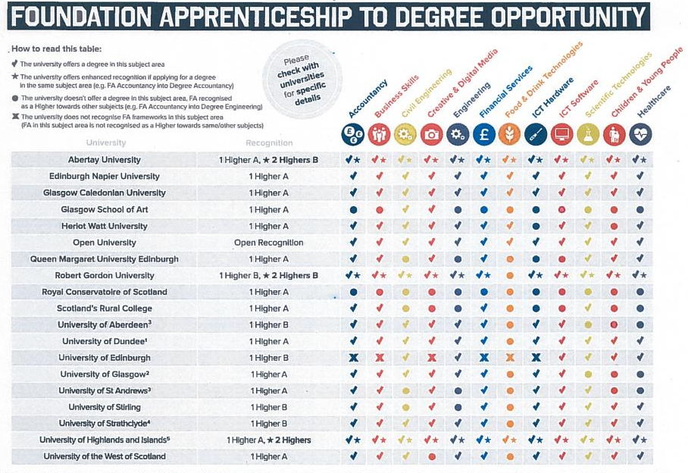

Slide 14
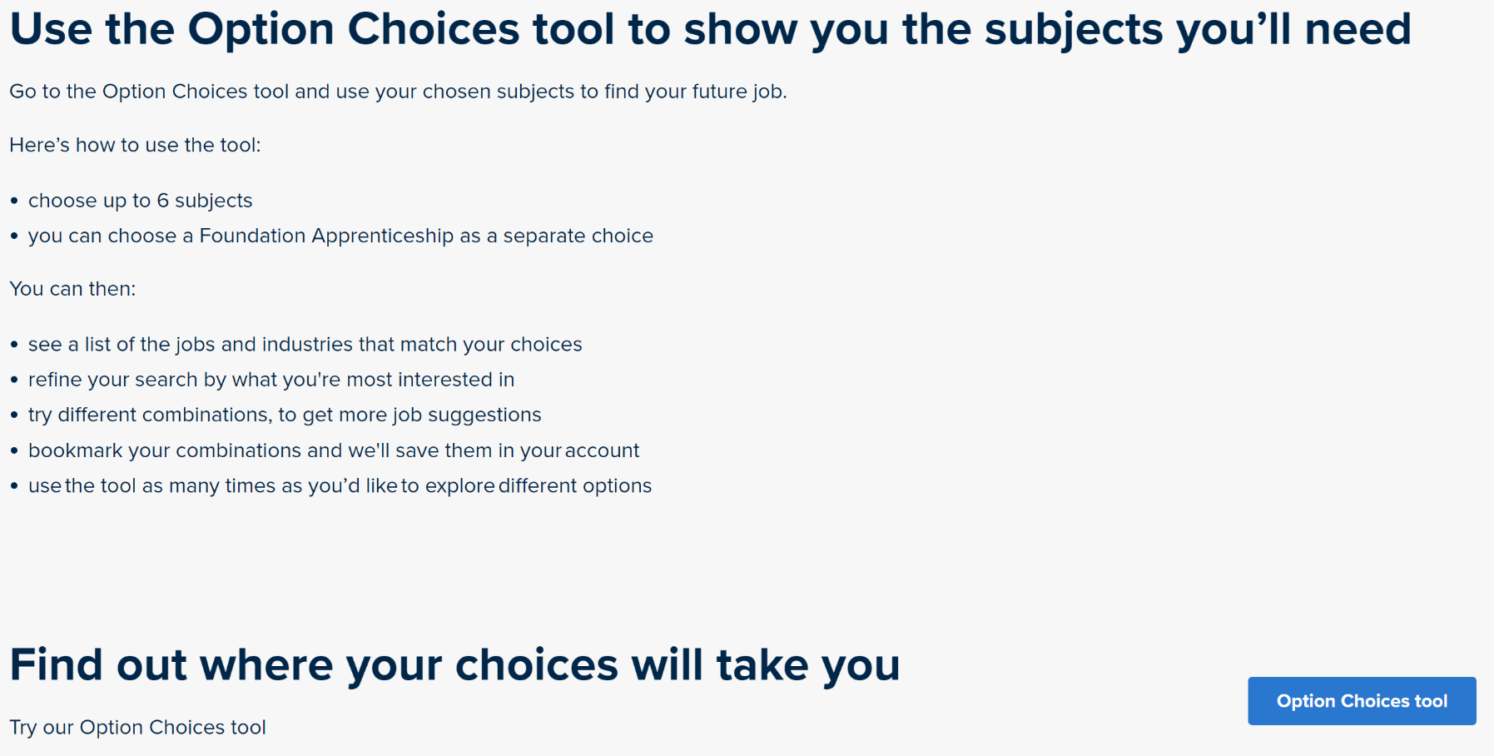
My World of Work:
https://www.myworldofwork.co.uk/my-career-options/choosing-my-subjects

Slide 15
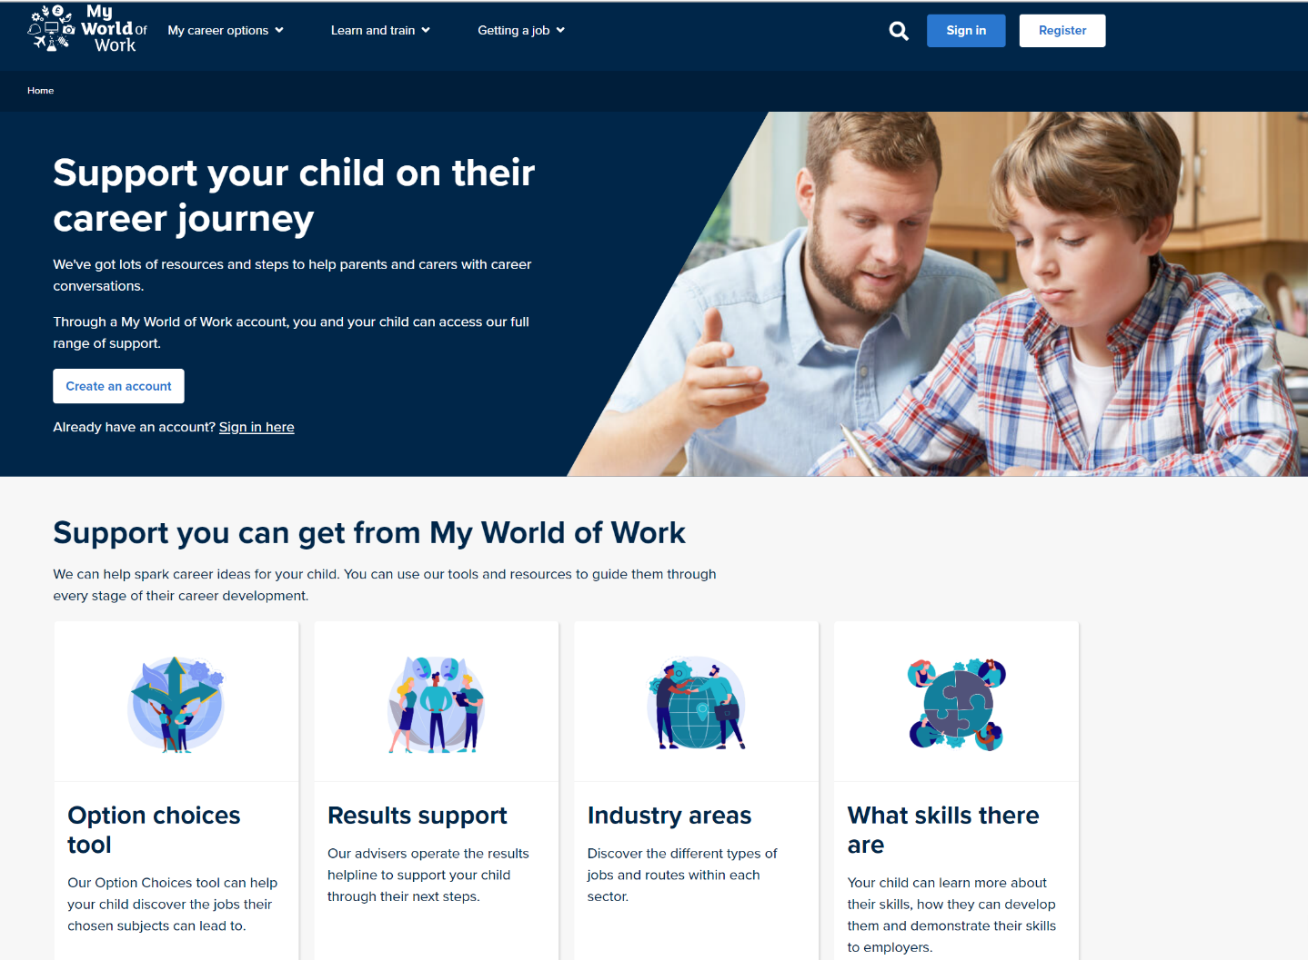
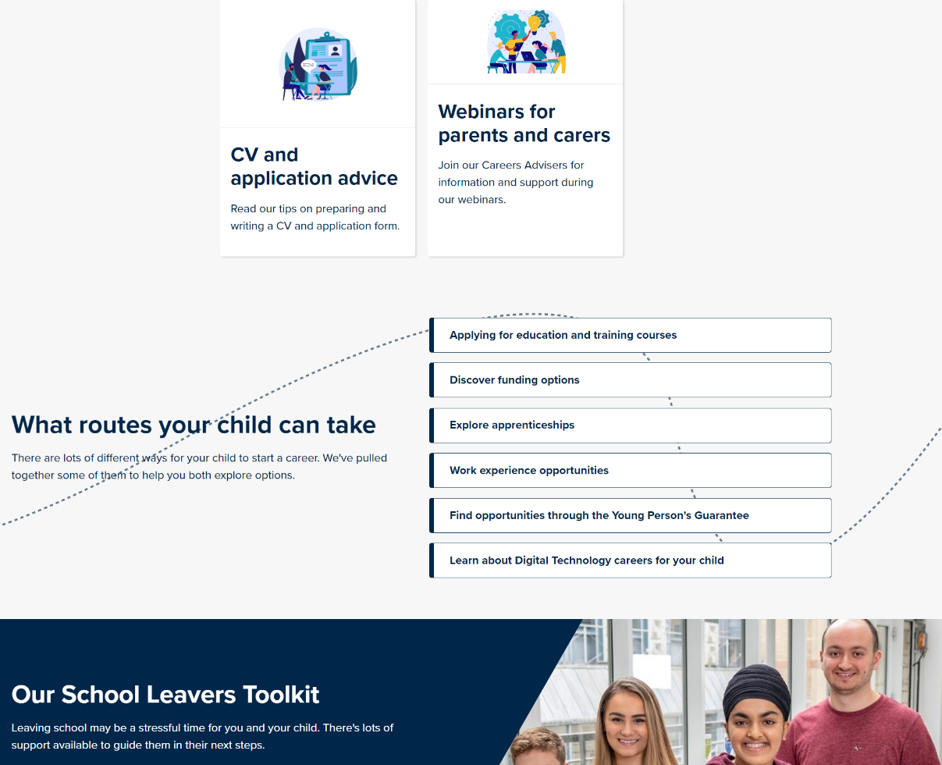
My World of Work
Supports
Skills Development Scotland
TGS support:
Lisa.OBrien@sds.co.uk

Slide 16
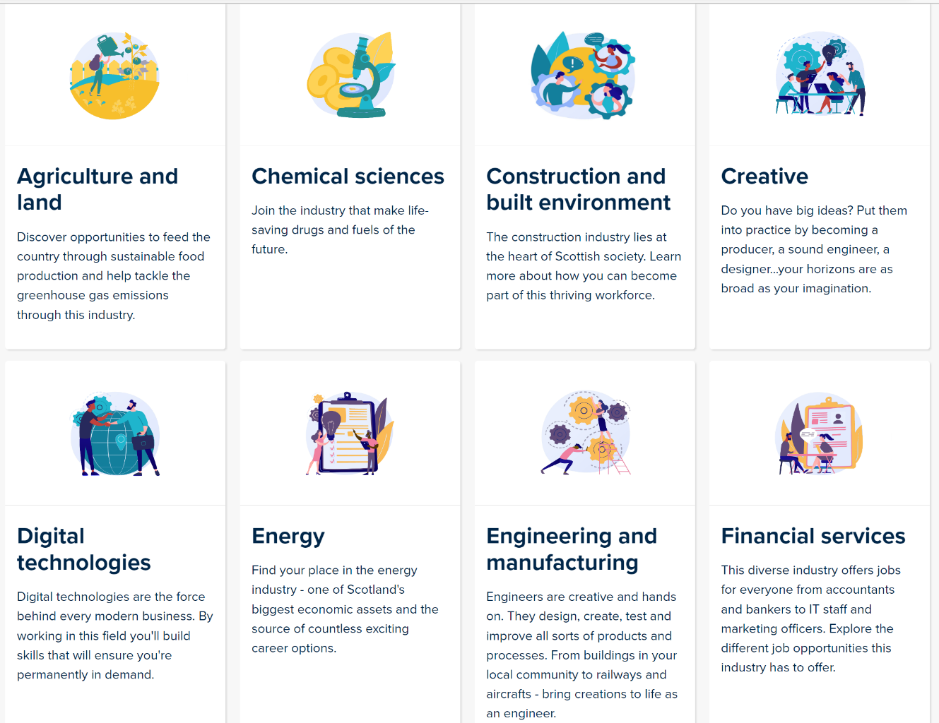
My Kid's Career:
https://www.mykidscareer.com/

Slide 17
NESCol: School College Link Courses
When being taught by a College lecturer young people will be treated like a College student.
College is an adult learning environment and we expect the same adult behaviour of school pupils as we do of our full time students.
College courses can mean missing some school classes – so additional commitment to catching up on missed work is essential
When attending a College course we expect pupils to behave as though they are arriving at work – on time and well prepared

Slide 18
Subject Areas include:
Digital Media
Civil Engineering
Construction
Automotive
Early Education and Childcare
Health Sector
Computing
Sport
Hospitality
Travel and Tourism
Marketing and Events
Psychology
Engineering
Accountancy
Laboratory Science
Beauty Therapy
Maritime
Those in bold are courses that have been taken by TGS pupils

